Slide 1

30-Day Gratitude Challenge
Team Samaddar, Gr. 5 & 6. Raymer Elementary
May/June 2020

Slide 2
The COVID-19 pandemic has prompted changes to our education system unlike any we have ever seen before. One thing we know for sure, though, is that as a class, grade five and six students together with our families, we truly collaborated even more closely to connect, work, learn and grow during this historic time - a time that will we forever share and cherish in our memories.
Team Samaddar Comes Together!

Slide 3
This Gratitude Challenge Photo Project tasked Team Samaddar students to identify what they are grateful for and express gratitude visually over a 30-day period over May and June.
By sharing their project with our Raymer Learning Community their wish is that others see, too, that by centering on an attitude of gratitude each day can help us all to be happier, keep positive, cherish good experiences, deal with adversity, and build deeper relationships.

Slide 4


Slide 5
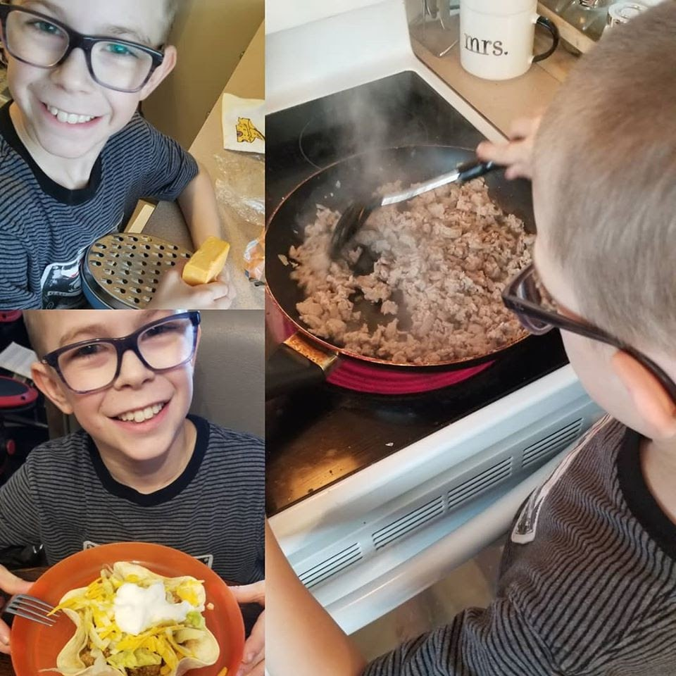
Alexander
I am grateful cooking in the kitchen with my mom

Slide 6
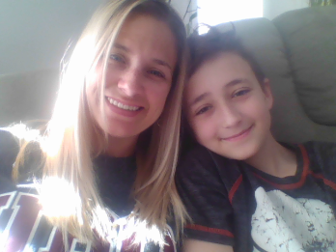
Waylon
I’m grateful for my mom because she
is very nice. She has been helping me
out with all my school work and she
makes everything easy.

Slide 7
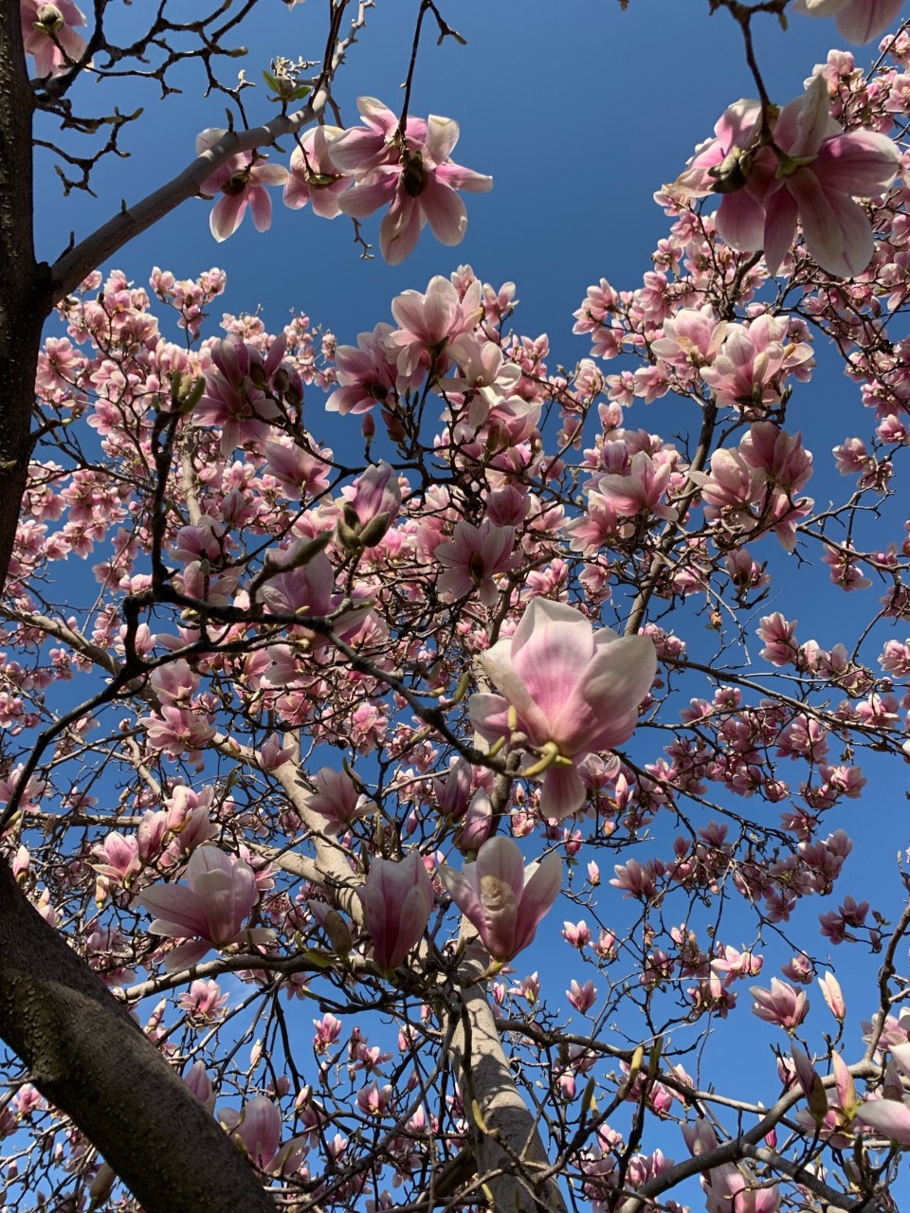
Mrs. Samaddar
I am grateful for my
beautiful backyard - watching my magnolia tree bloom at each year at the start of Spring, the smell of pink blooms, special!
I am also grateful for my amazing students!
Notes:
Mrs. Samaddar - magnolia tree in my back yard

Slide 8
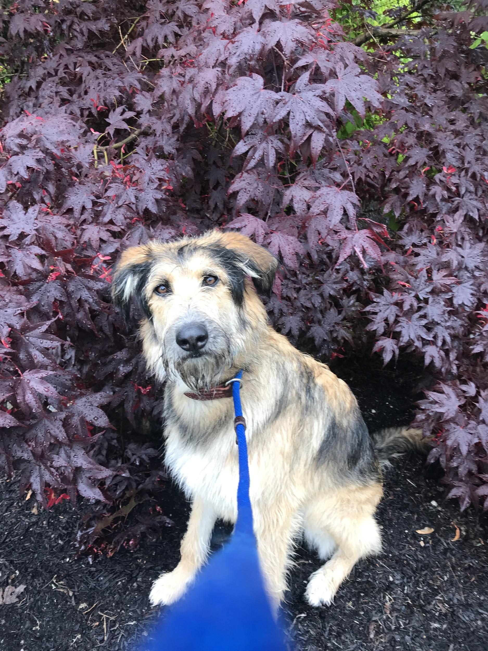
Marie
My dog Millie has helped me a lot - by getting me outside, making me take breaks and I adore her cuteness. I don't know what I would have done without my dog during COVID-19.

Slide 9
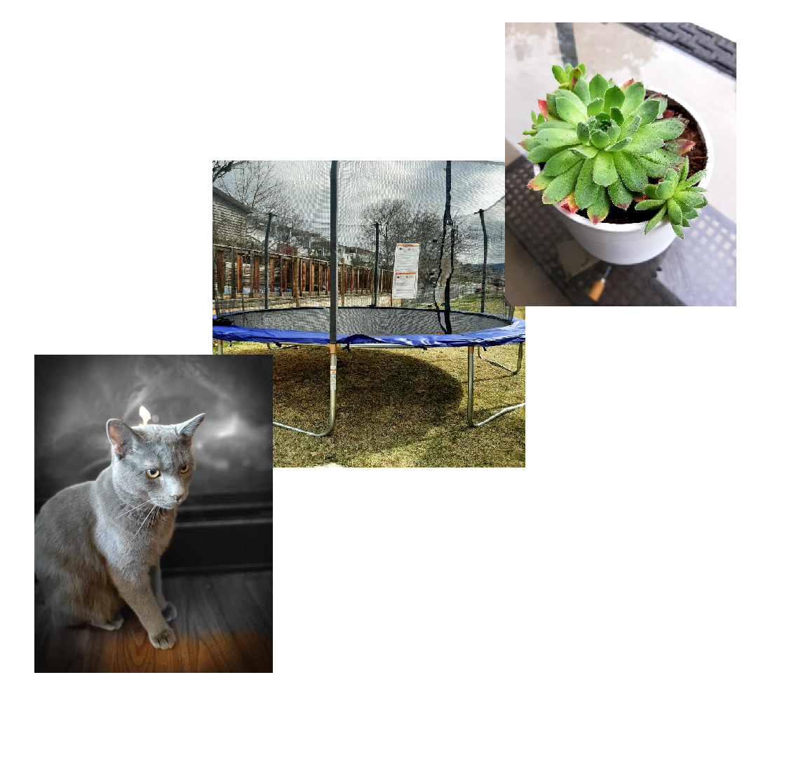
Riley
I’m grateful for:
My cats because they are sweet and loving. They are also very friendly.
My trampoline because it is giant and super bouncy and I can do so many flips on it. and lastly,
My plant because it is so beautiful and easy to take care of.

Slide 10
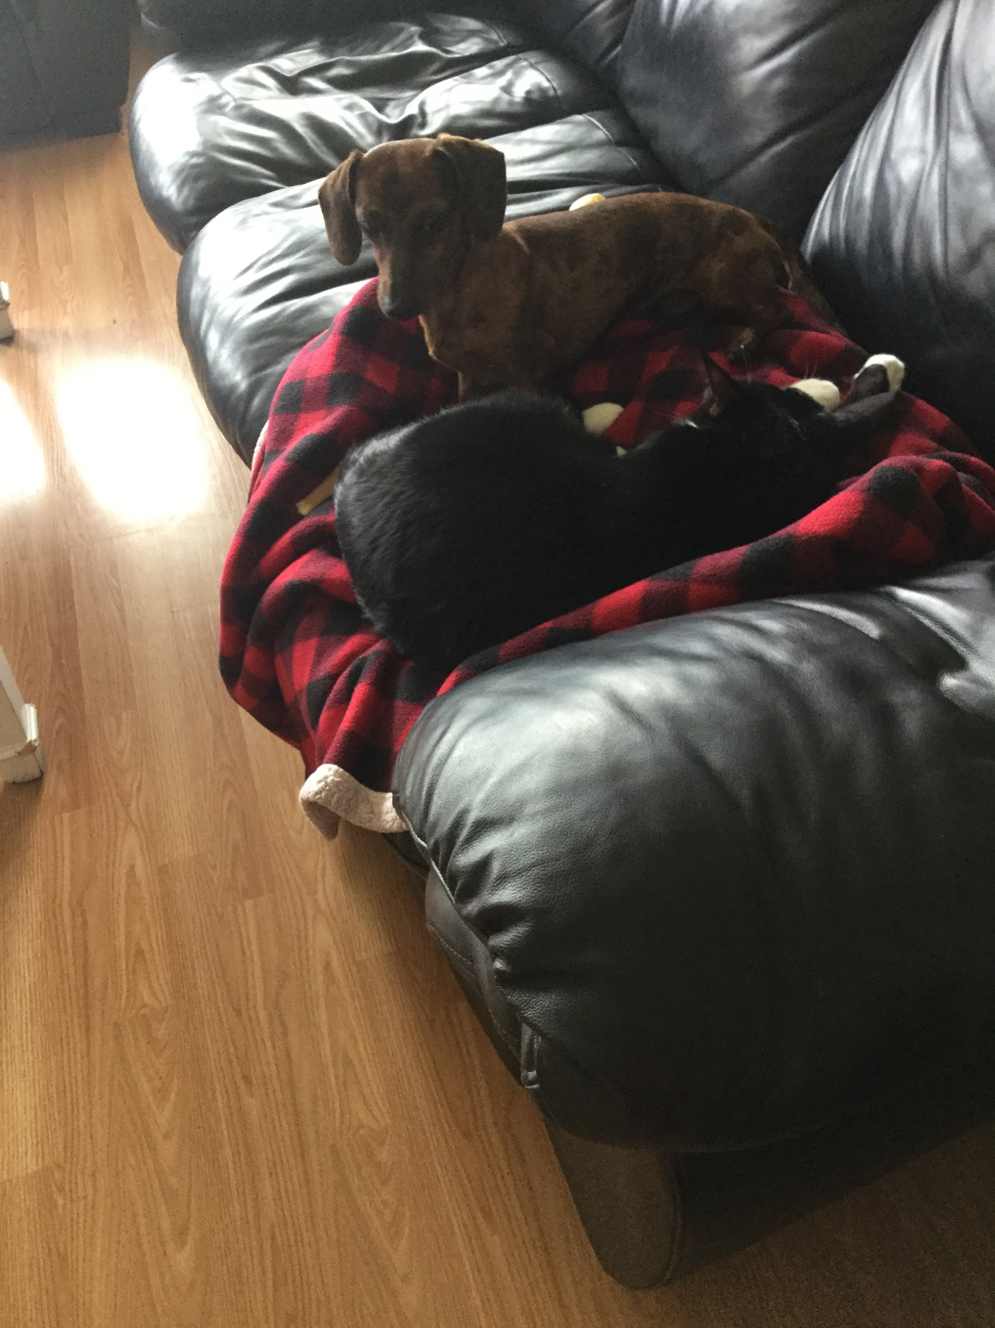
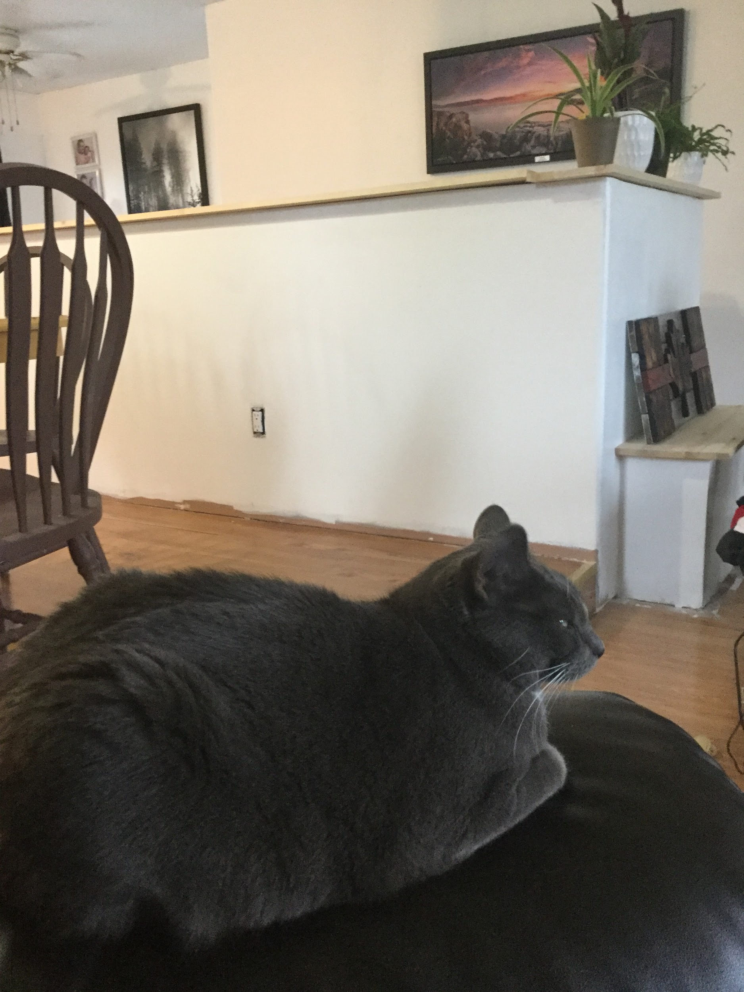
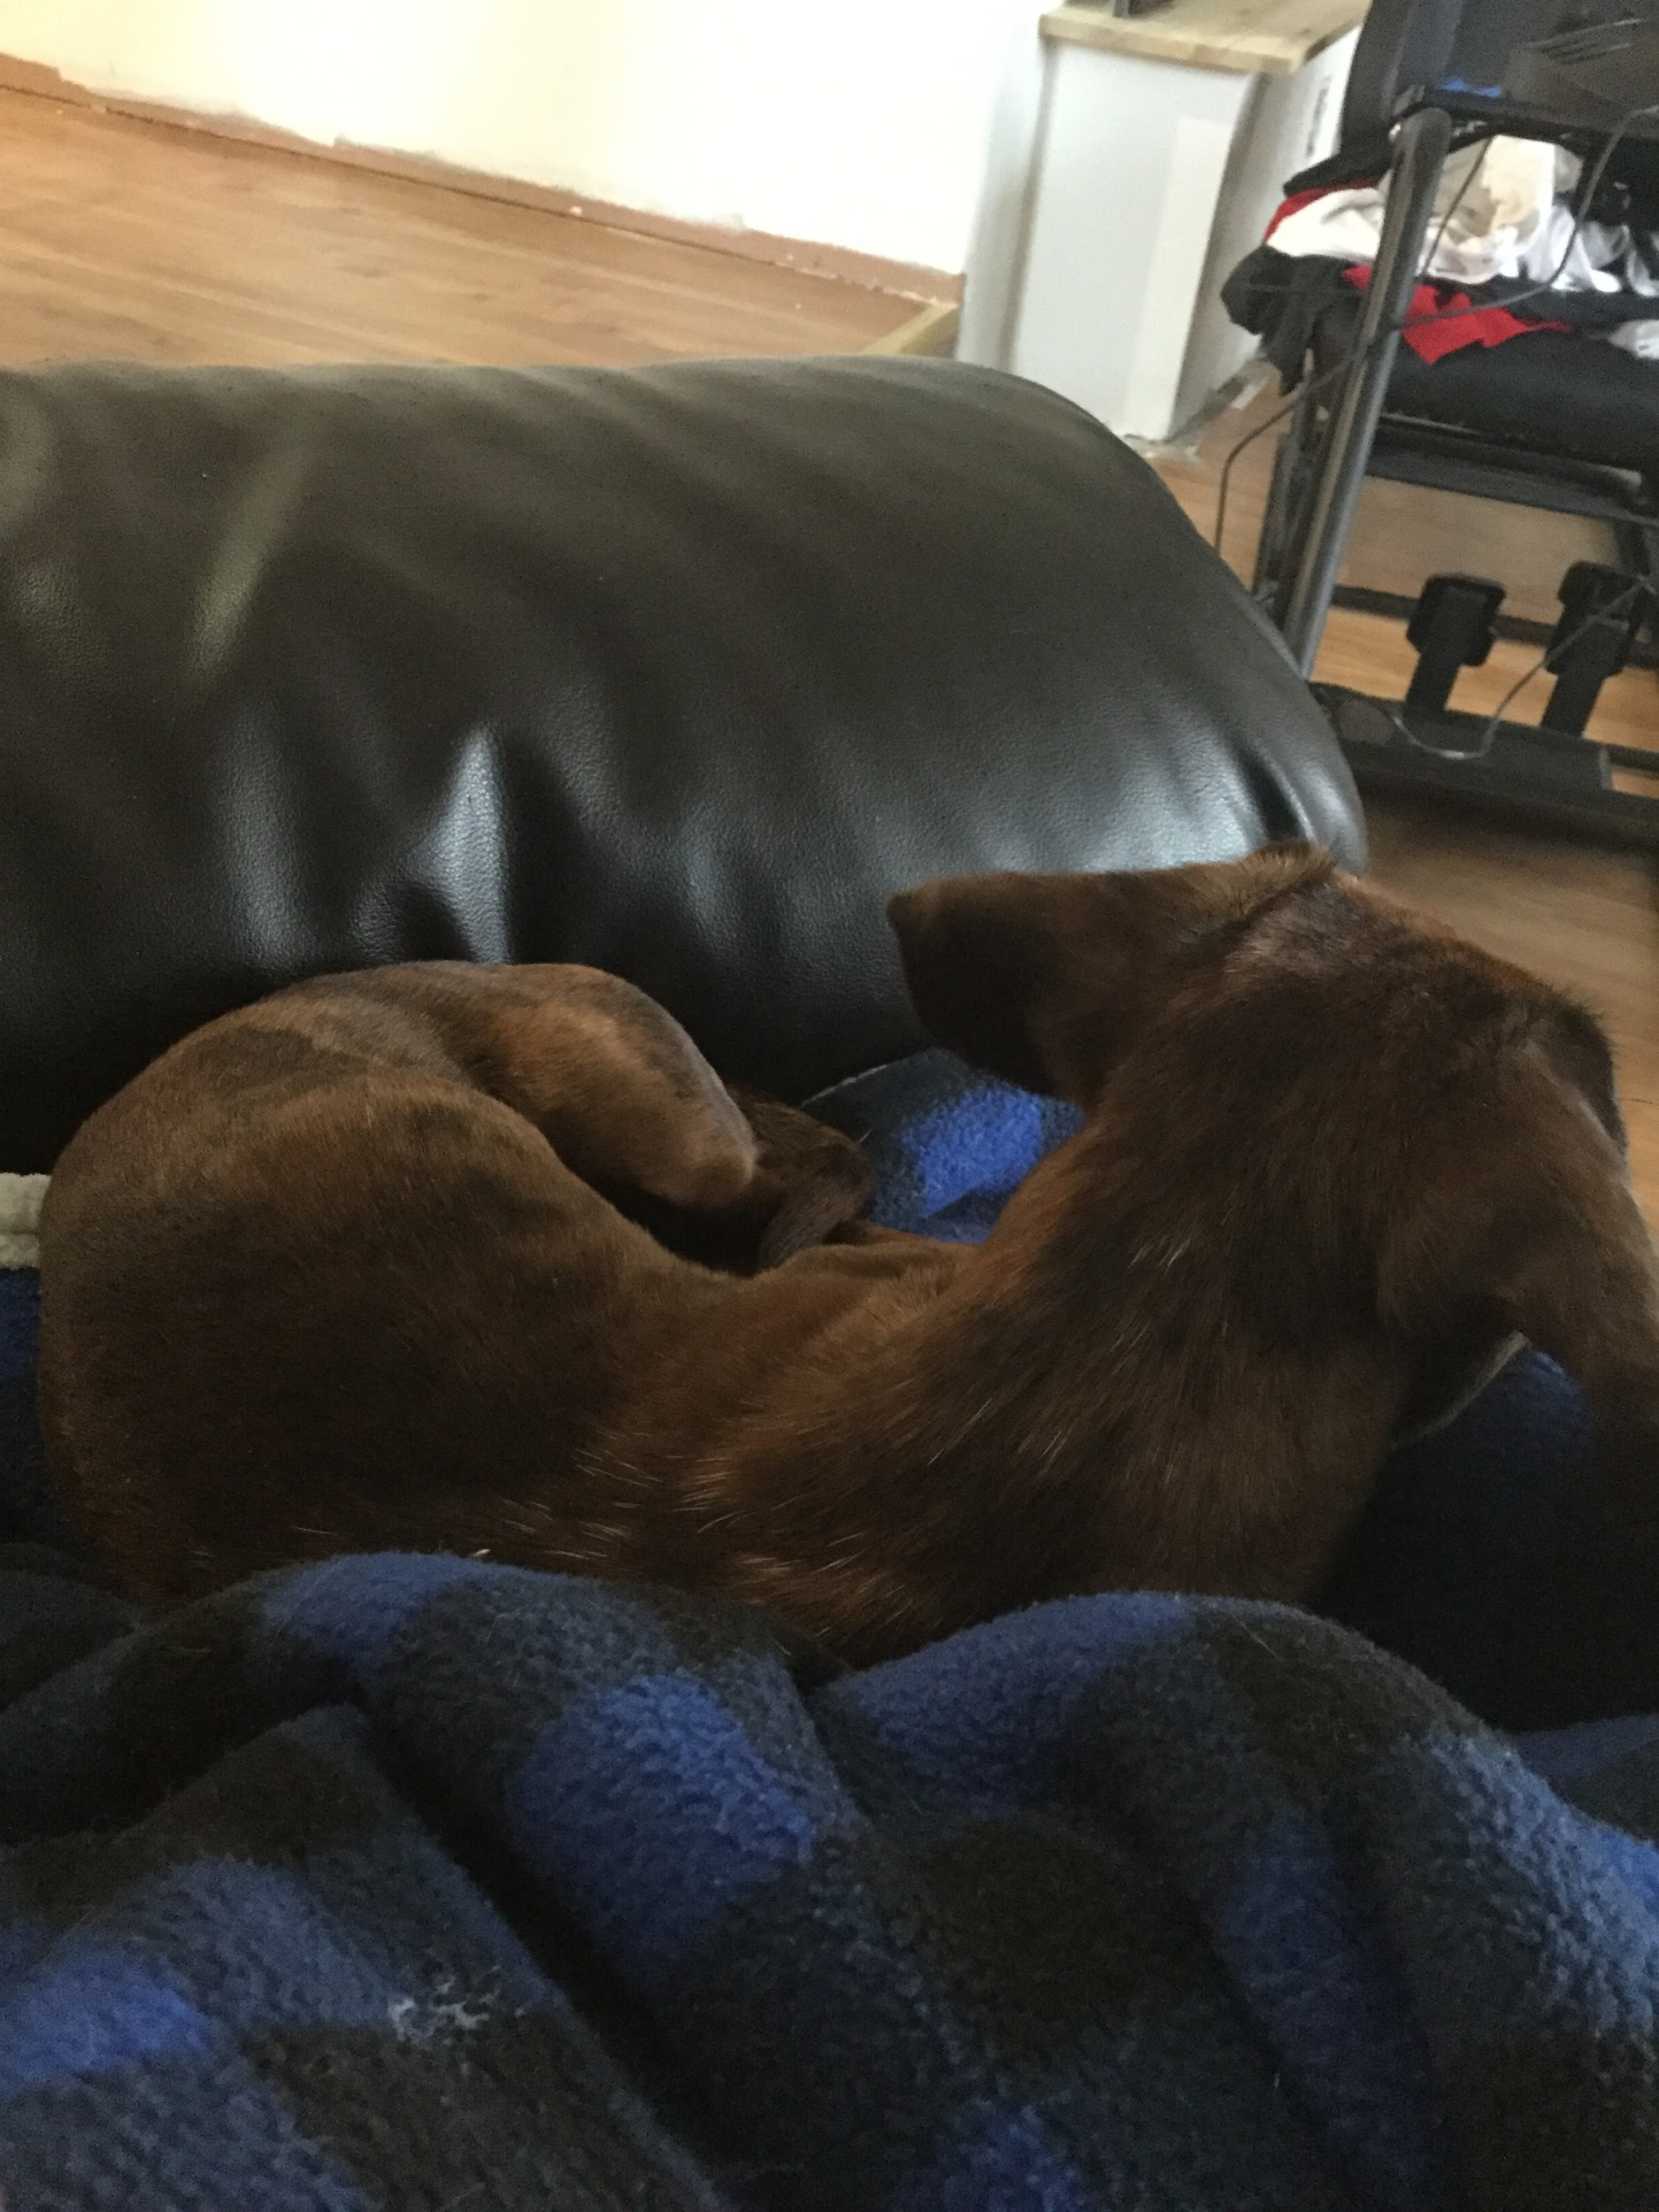
Gaby
I am grateful for my animals - first my dog Flash, He loves to play outside and he is very cuddly.
Next is my cat Smokey. She loves to sleep but she also loves to cuddle and bite people.
Lastly my other cat onyx he loves the sink and loves to play and cuddle you. Onyx is black and smokey is grey and flash is the dog

Slide 11
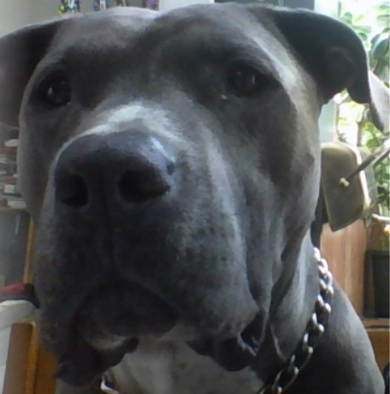
Zaya
I am grateful for Nero my dog because he is funny,
I love to play with him, He always tries to sit on top of me and on my feet he makes me happy in these sad times and that I can go to the lake to swim and play on my new paddle board

Slide 12
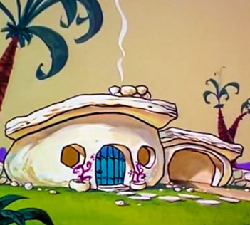
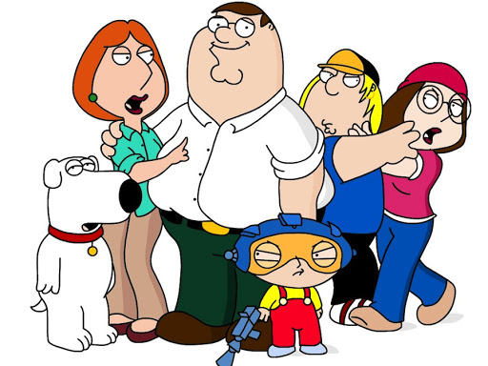
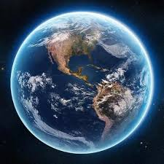
Isaiah
I’m grateful for the world a house and family by my side at all time and I can talk to them at any and I thankful for miss.abbott.

Slide 13
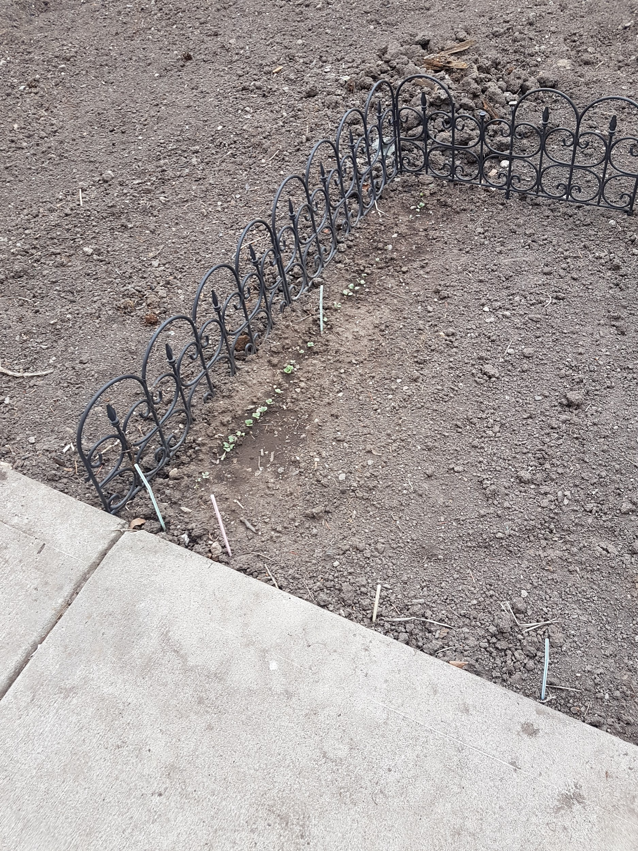
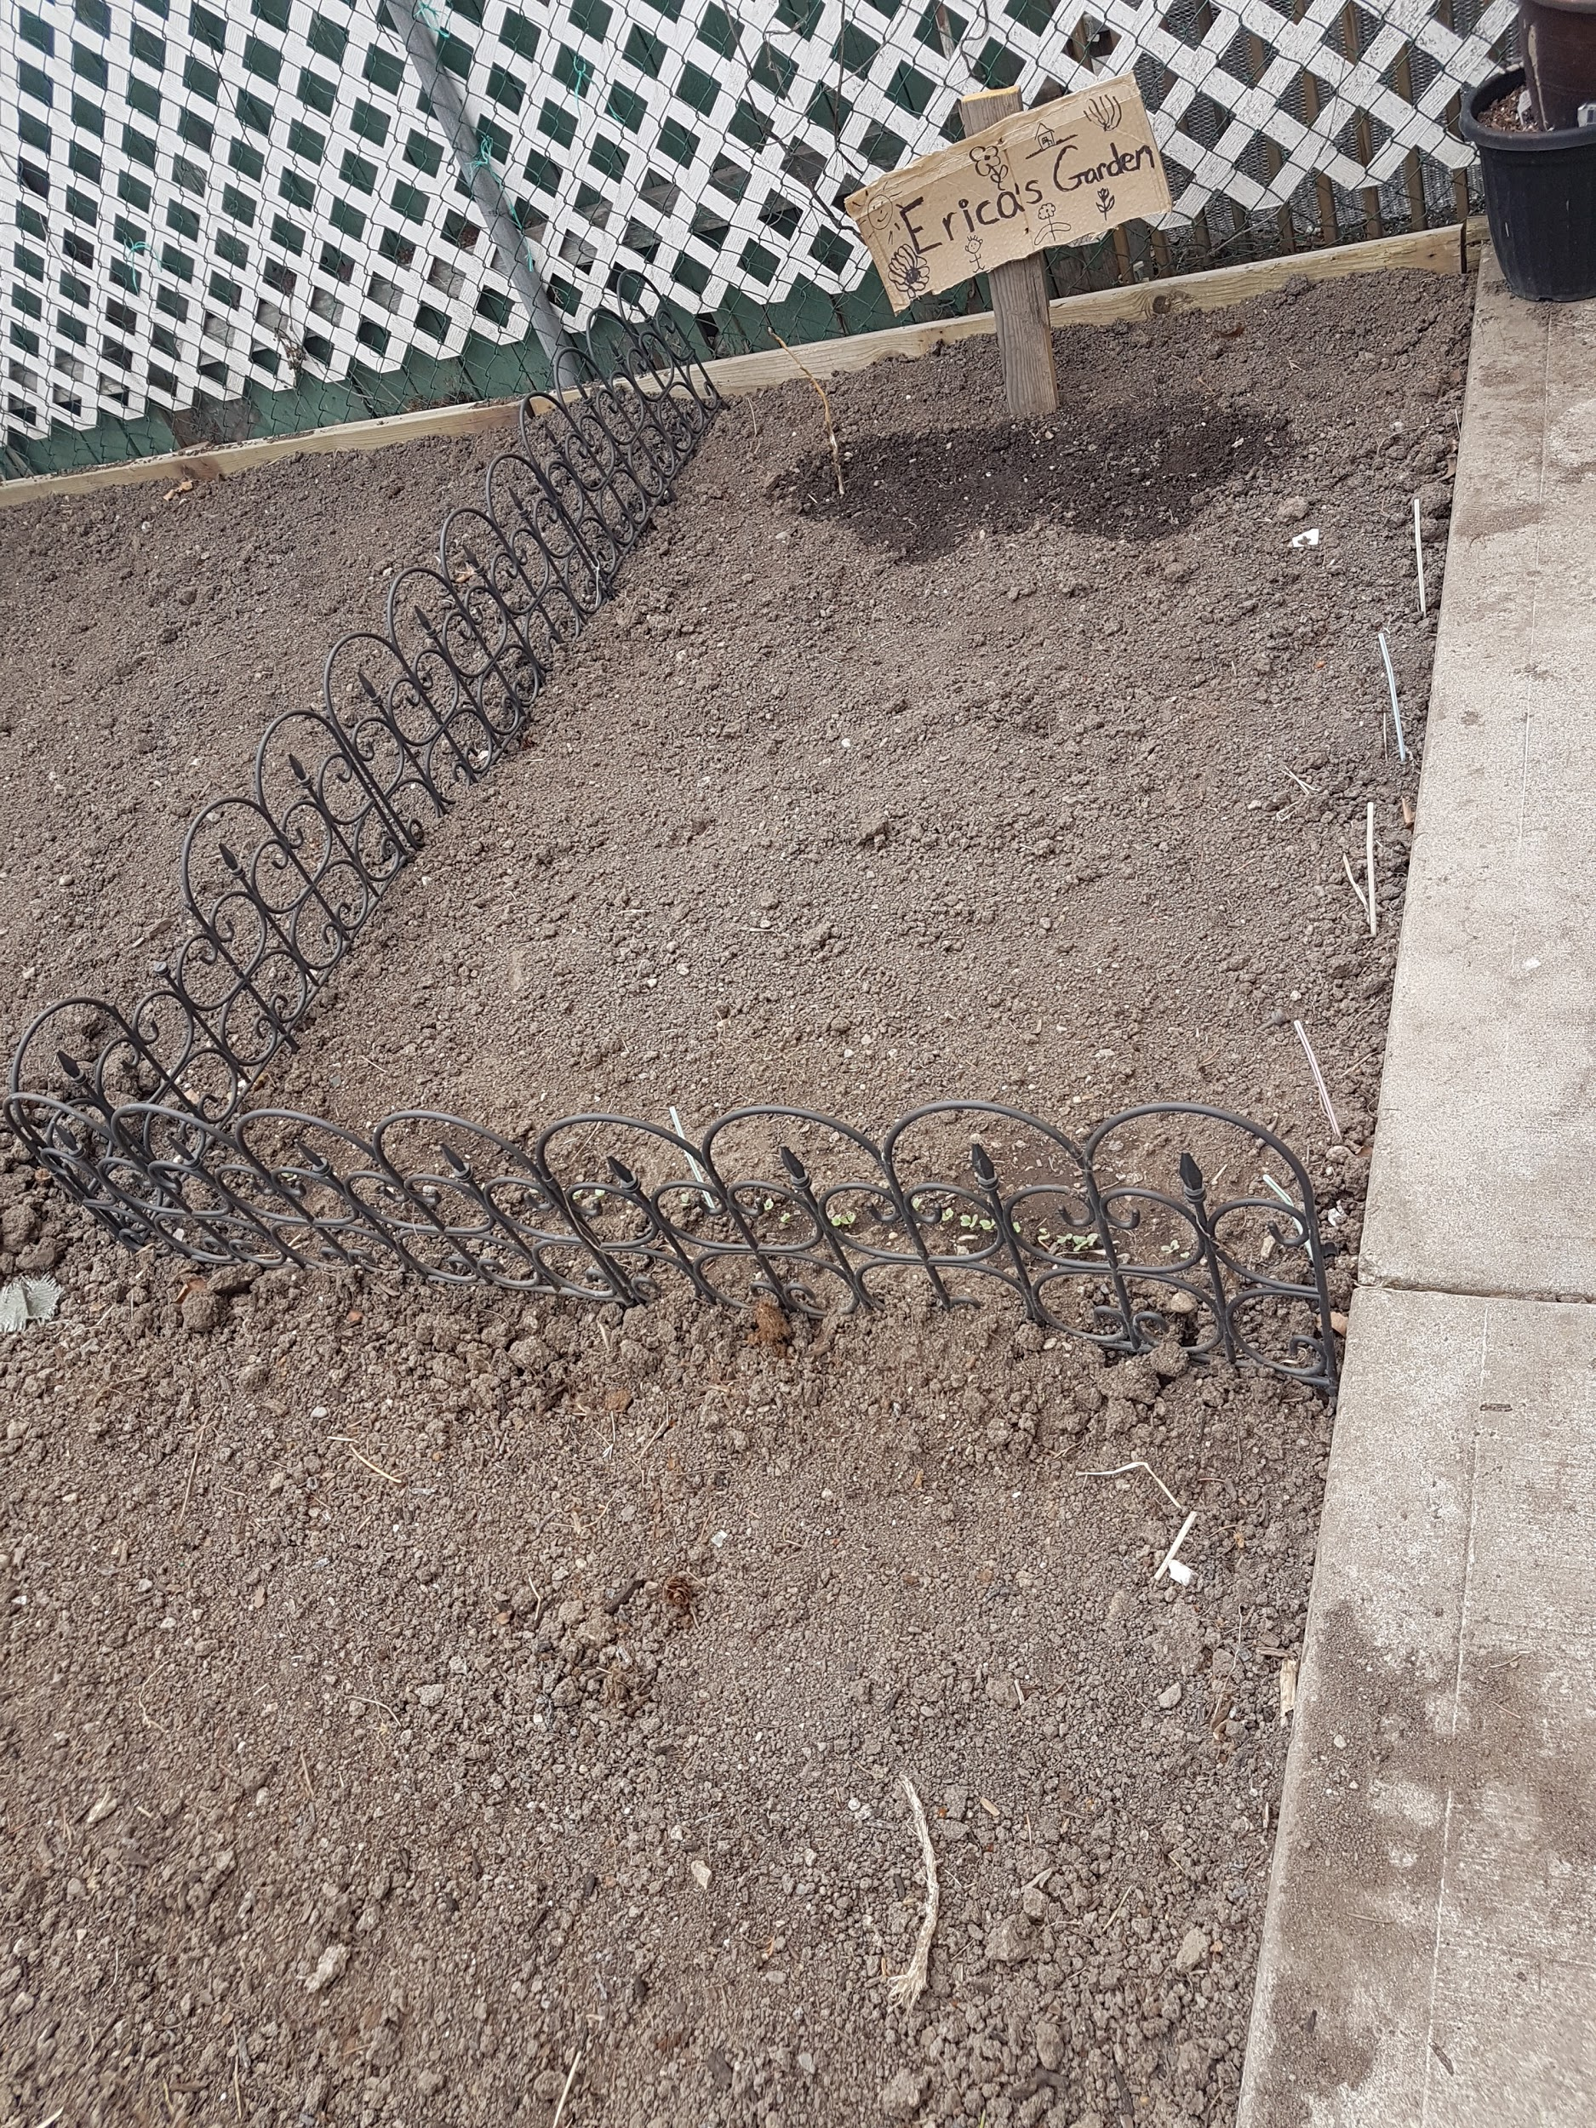
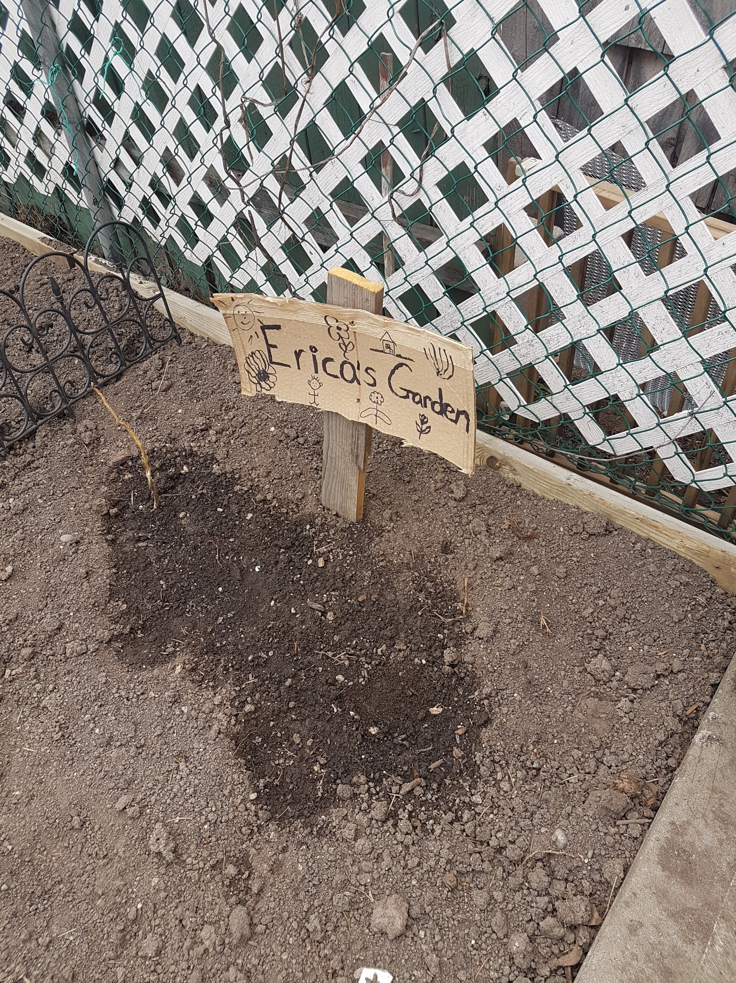
Erika
I’m grateful for my garden because then we don’t have to go to the store for veggies, and it’s a fun hobby to do when I have free time. Having a garden is like having your own children.

Slide 14
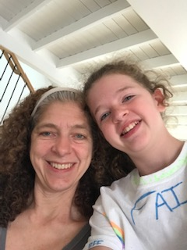
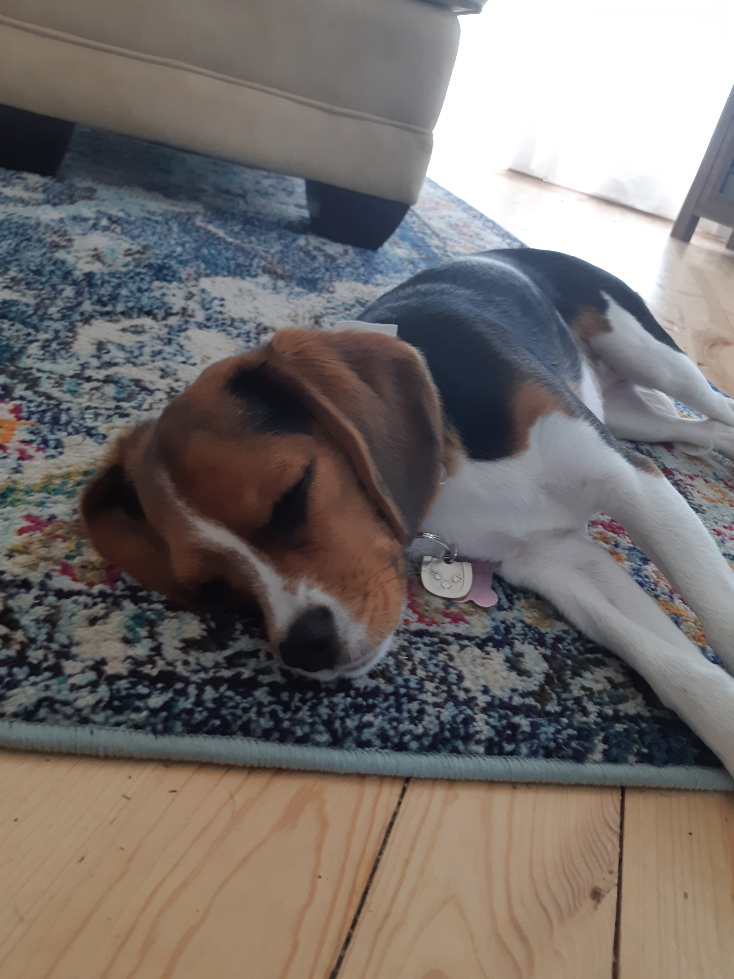
Caitlyn
I am grateful for my mom because she is helping me through the hard times right now.
2. I am grateful for my dog Willow because I love having someone to play with.

Slide 15
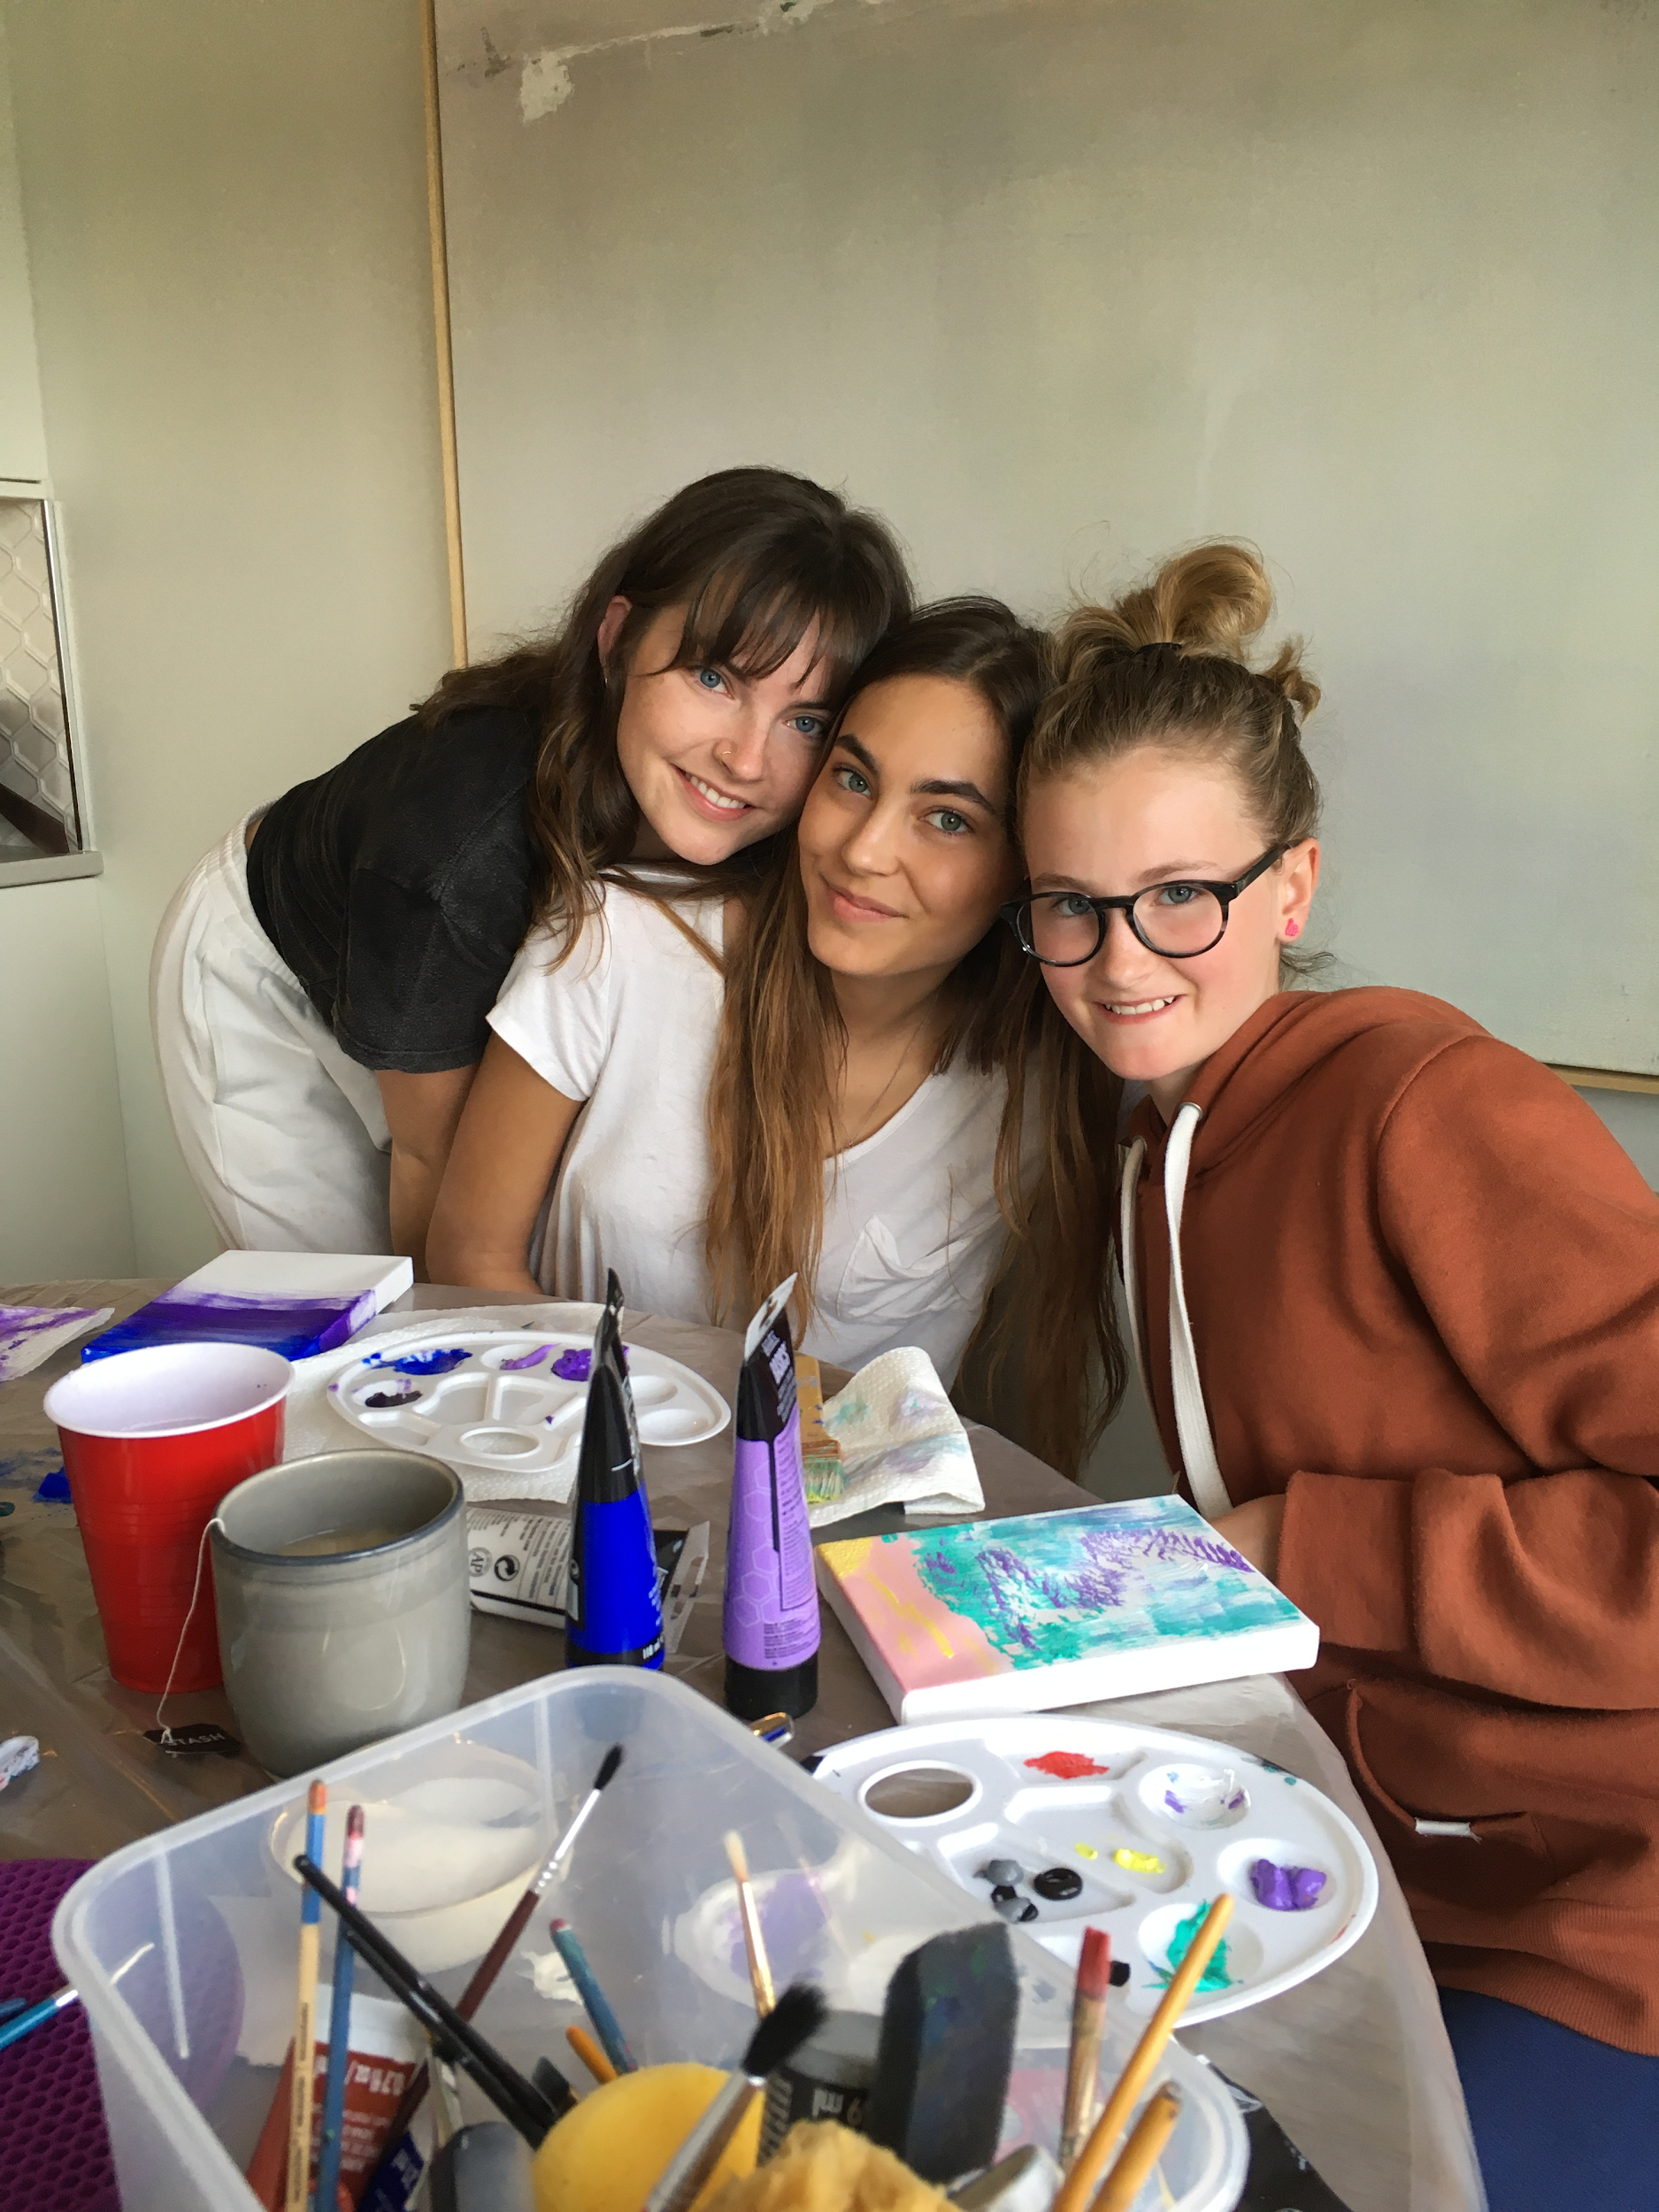
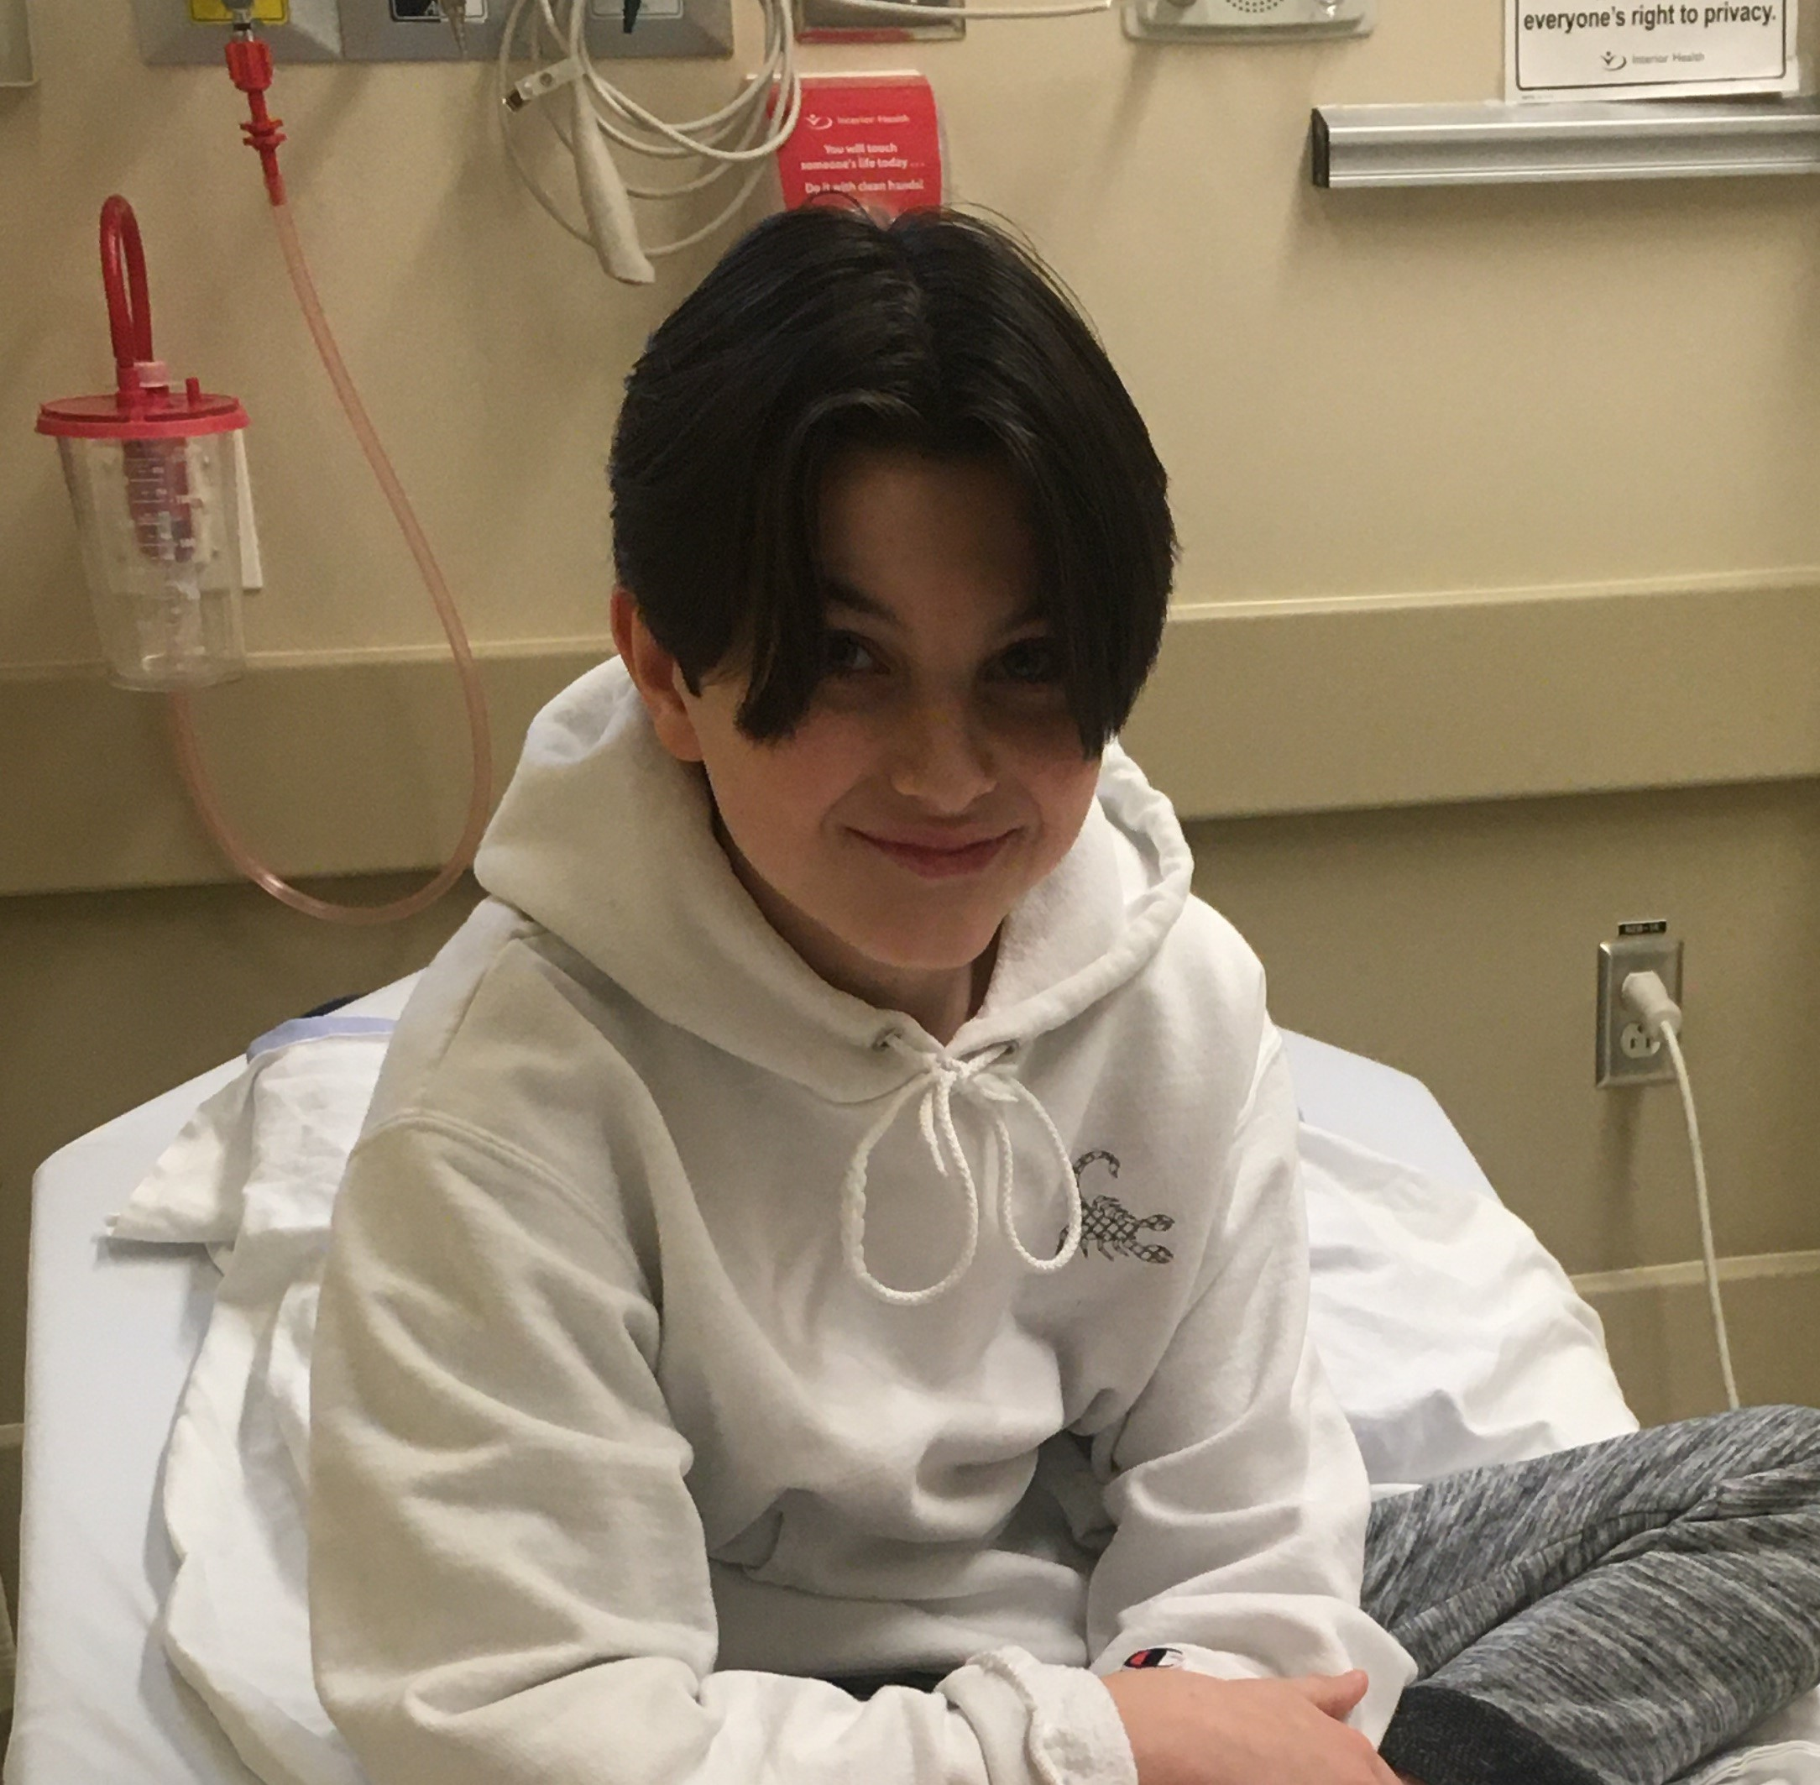
Julia
I’m grateful for my cousins Ava, Mataya, Thiesan that can paint with me, and make me laugh, and just have someone to hang out with.

Slide 16
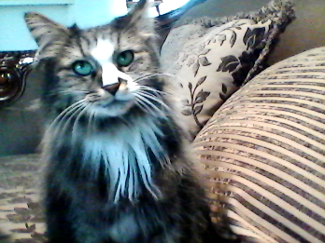
Genesis
I am grateful for my cat Love because she keeps me company
and that I have someone to play with.

Slide 17
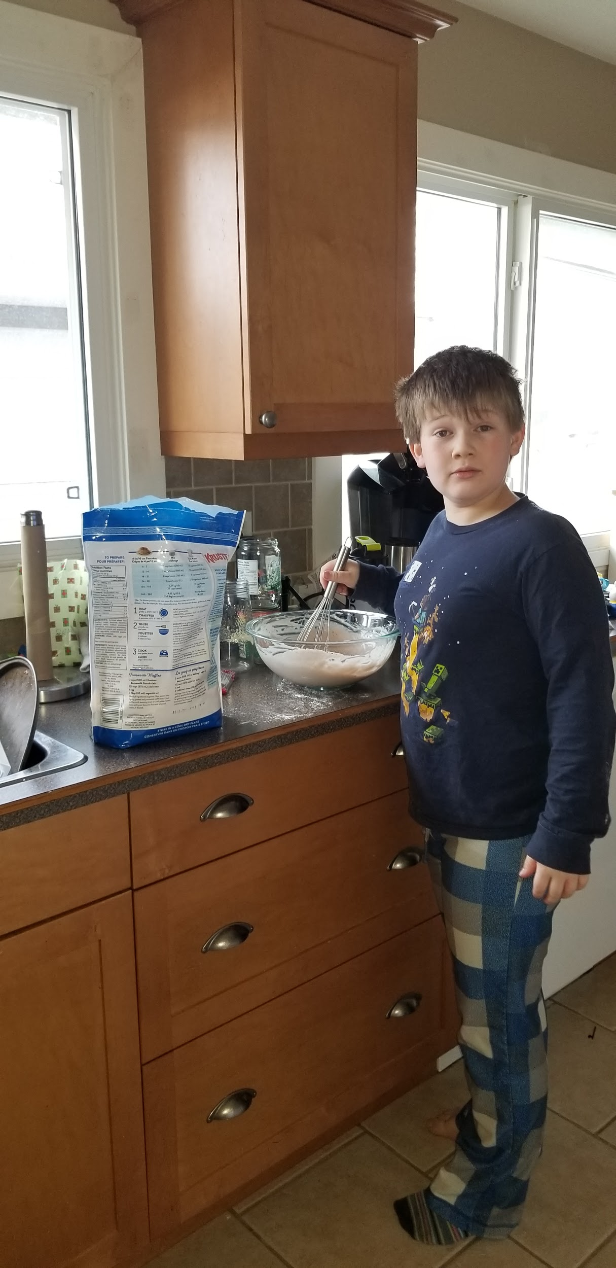
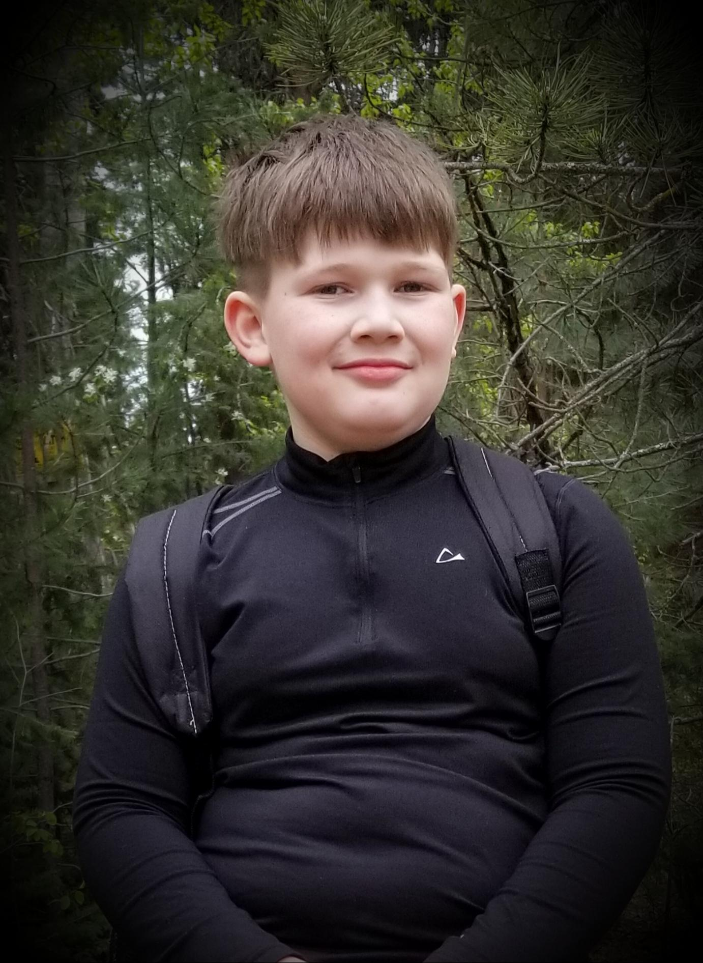
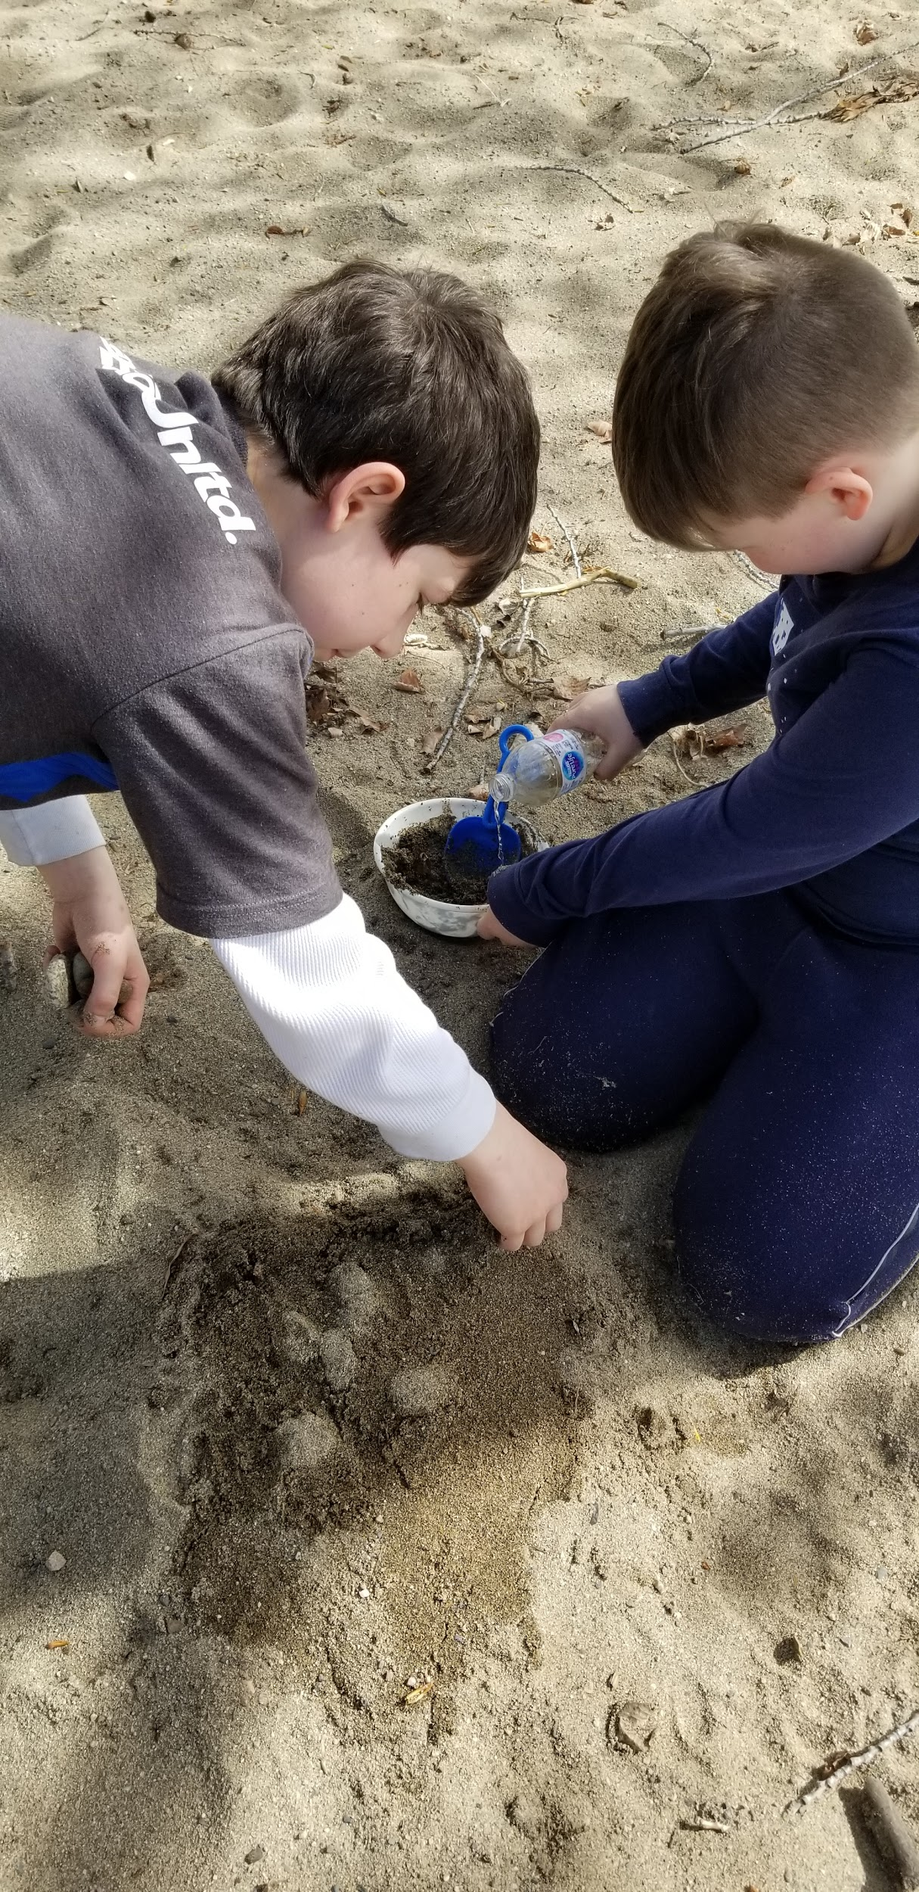
Brayden
I am grateful to be able to go for walks in Mission Creek Park, making pancakes and playing in the sand!

Slide 18
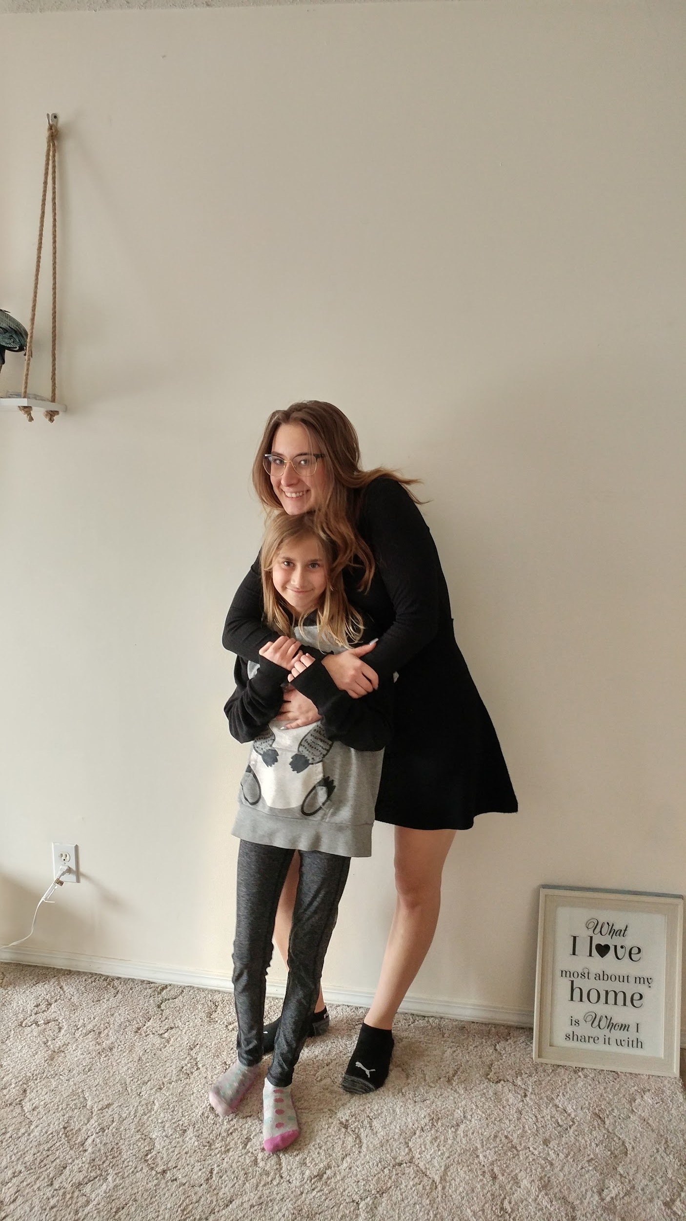
Kailei
I am grateful for my sister because she is always there for me and makes me feel happy.

Slide 19
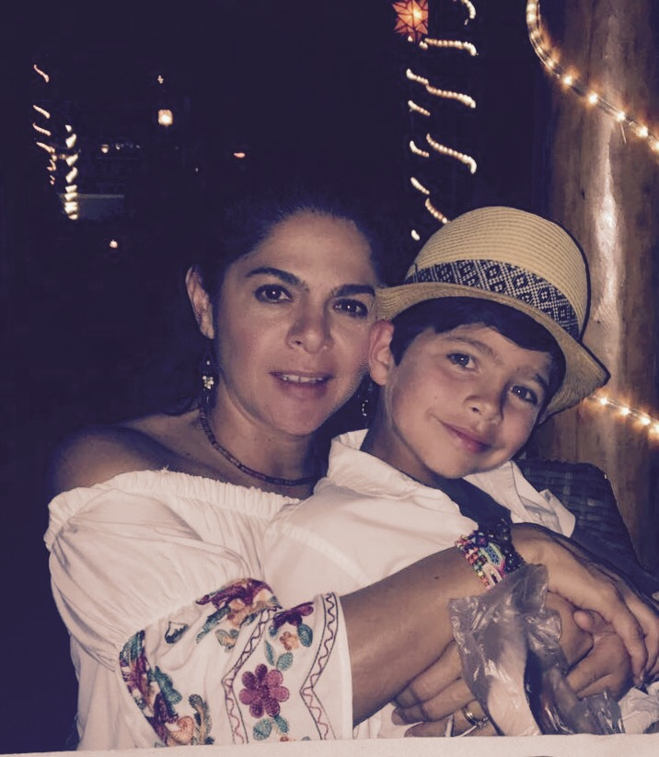
Diego
I am grateful for my mom because she is always there when I need her.

Slide 20
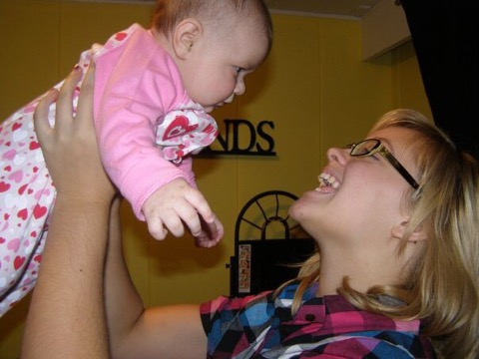
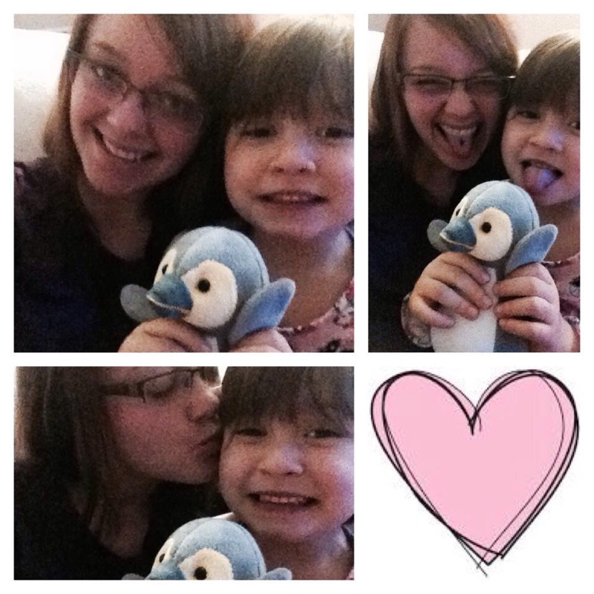
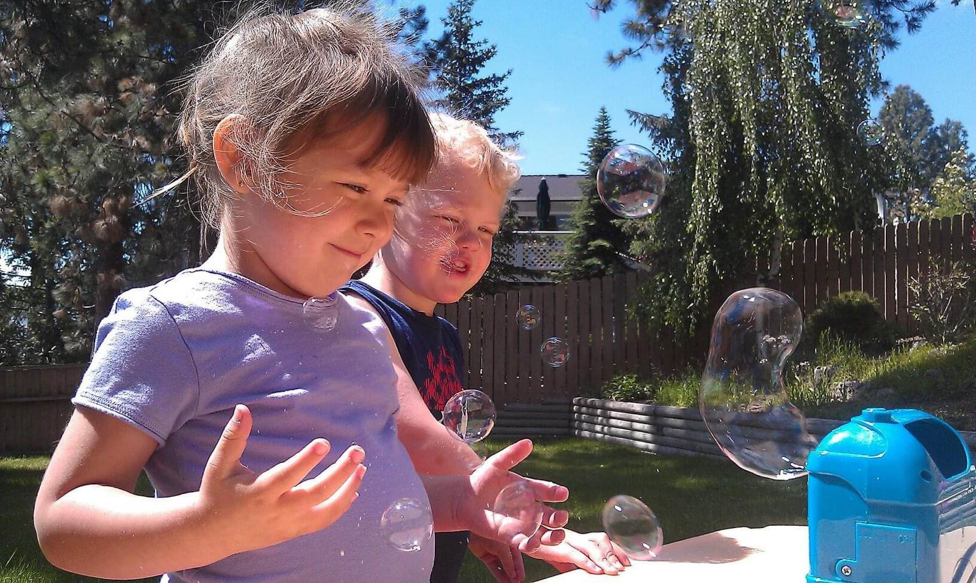
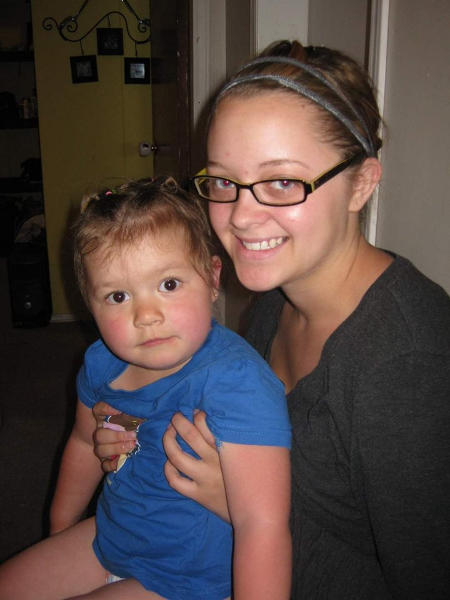
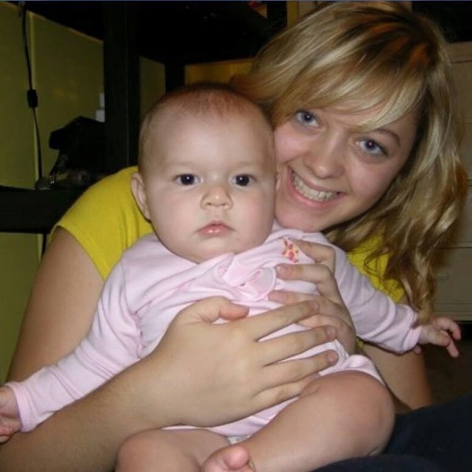
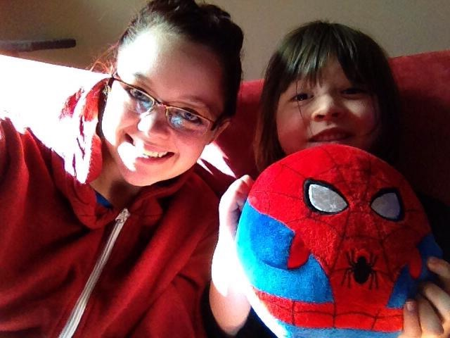
Anastasia
I am thankful for my Aunt Marina. She basically was my mom growing up even when she was still in high school she would take care of me. She moved away from Kelowna about 2-3 years ago to Alberta. I miss her a lot. I had so much fun when we went out. She would babysit this boy named William and i would come with her. I had best friends growing up, I would see him every day and I haven't seen him in about 6-7 years. He would be about 10 and he’s a year younger than me. I have so much more to tell, but thats for a different time.
Me and william

Slide 21
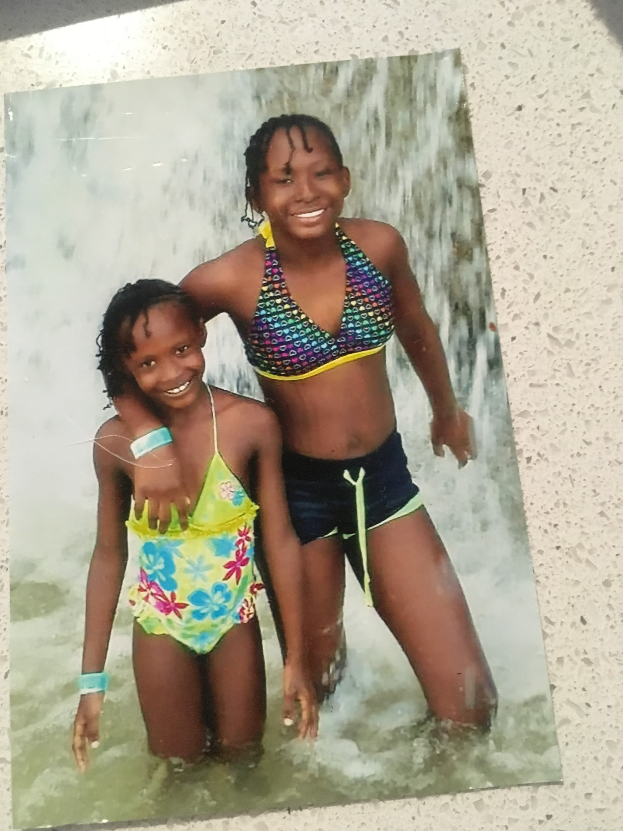
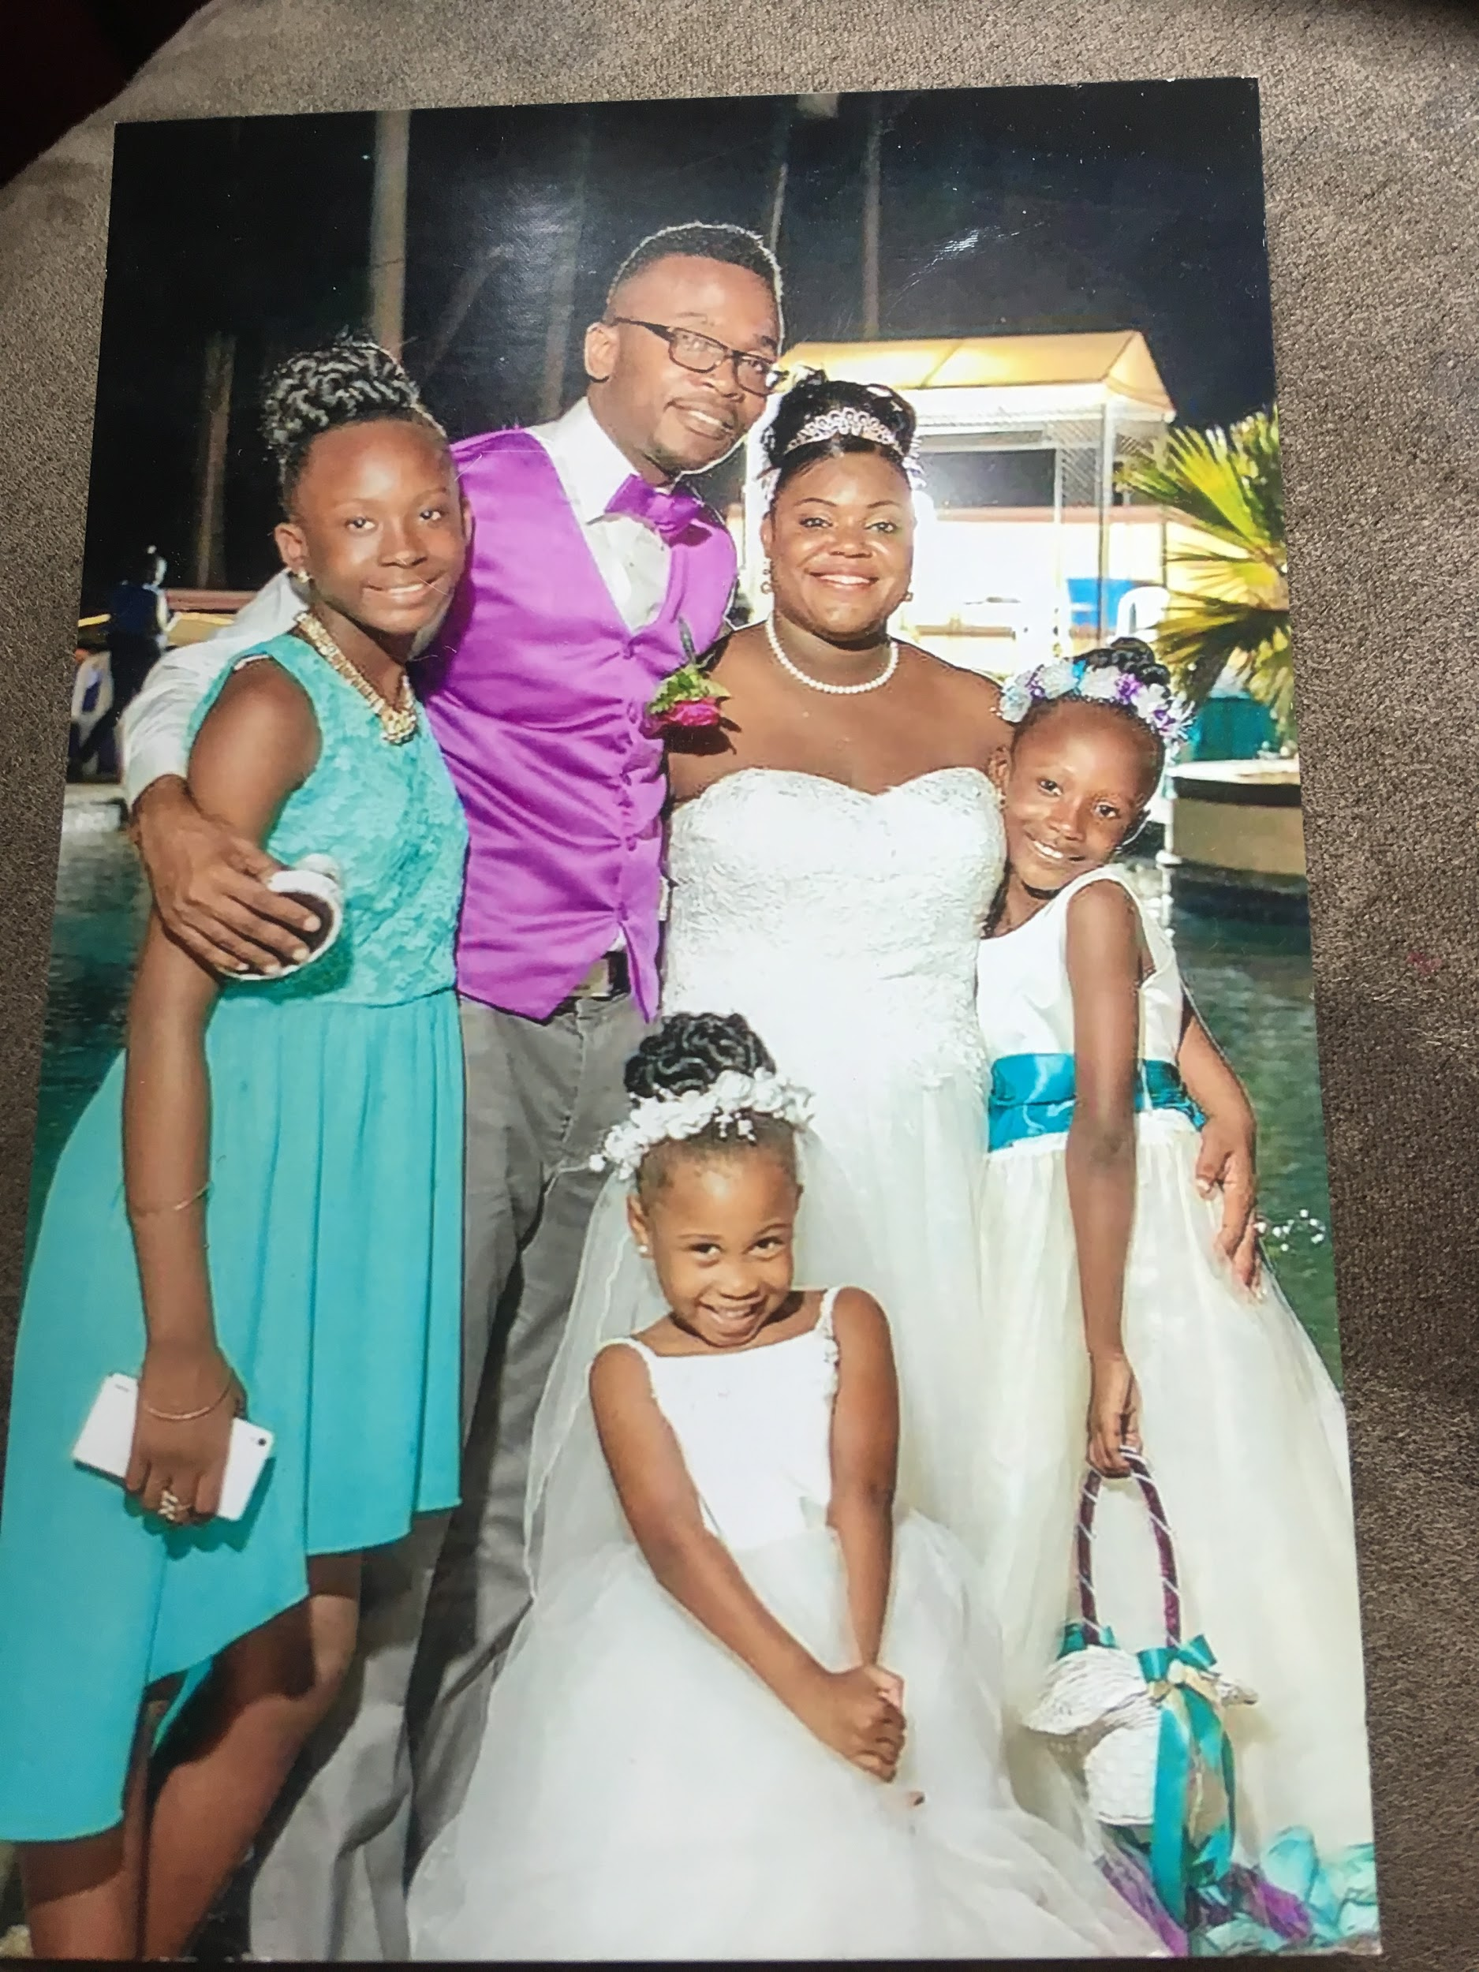
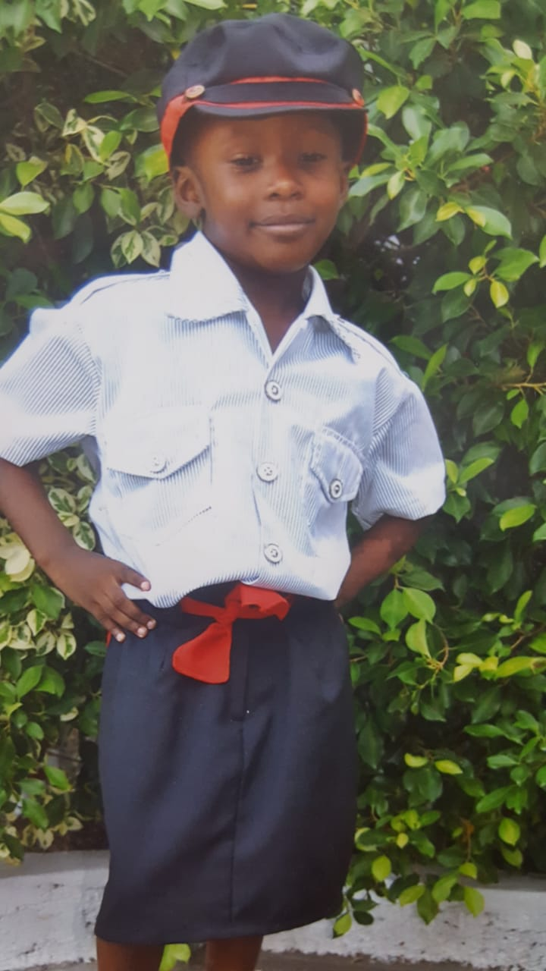
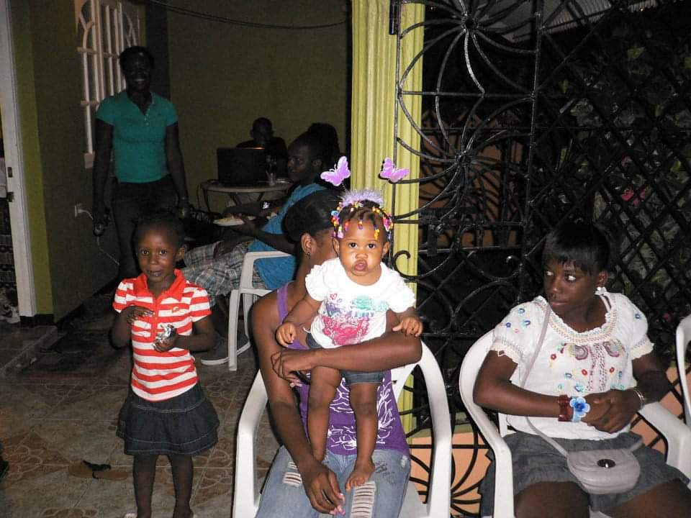
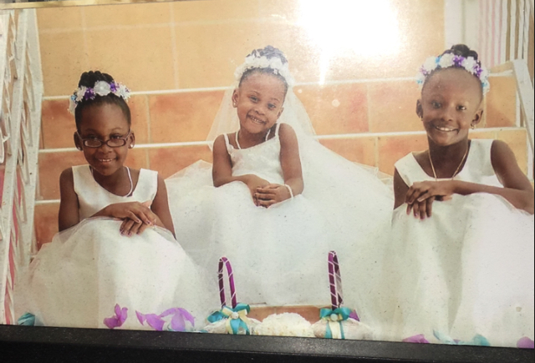
Gia
This when I was living in Jamaica and my family and I went to the beach.
In this picture I have my sister. Even though we fight alot and say mean stuff to one another we love each other very much.

Slide 22

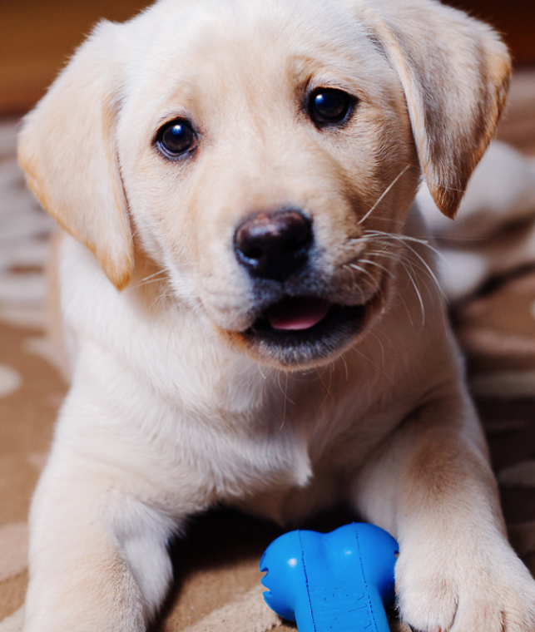
Josh
I am grateful for my dog because she is always able to cheer me up and play with me

Slide 23
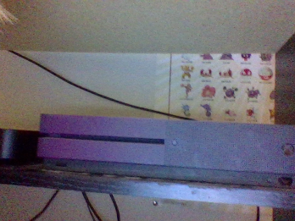
Ryder
I am grateful for my friends and XBox cause we can play on it and it entertains us while we are in quarantine.

Slide 24
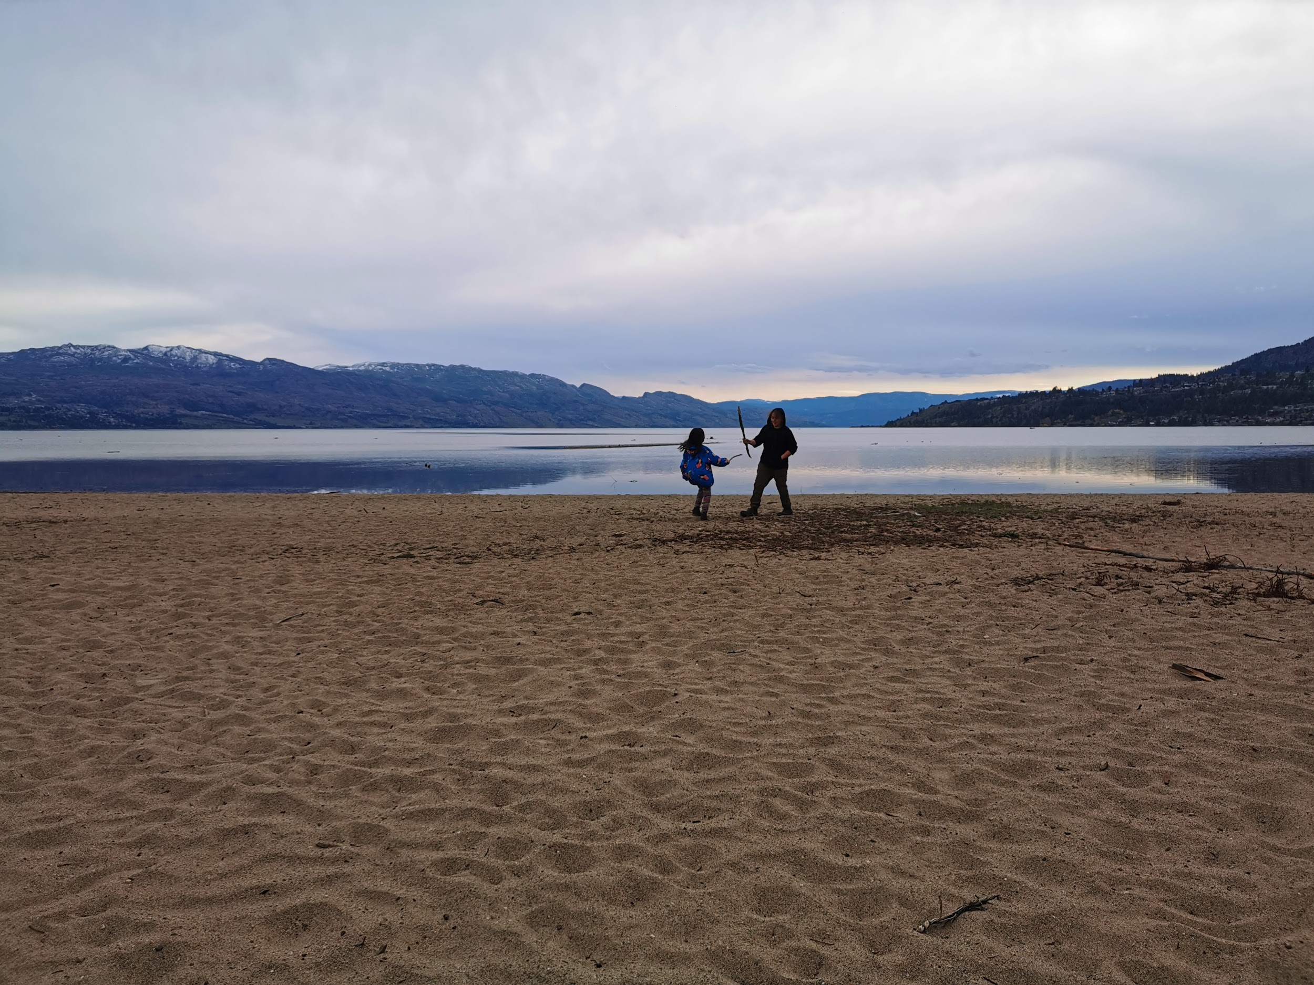
Martin
I am grateful for my sister because she makes me laugh. Sometimes when I play with her we fight between us,we laugh between us and a lot of things.

Slide 25
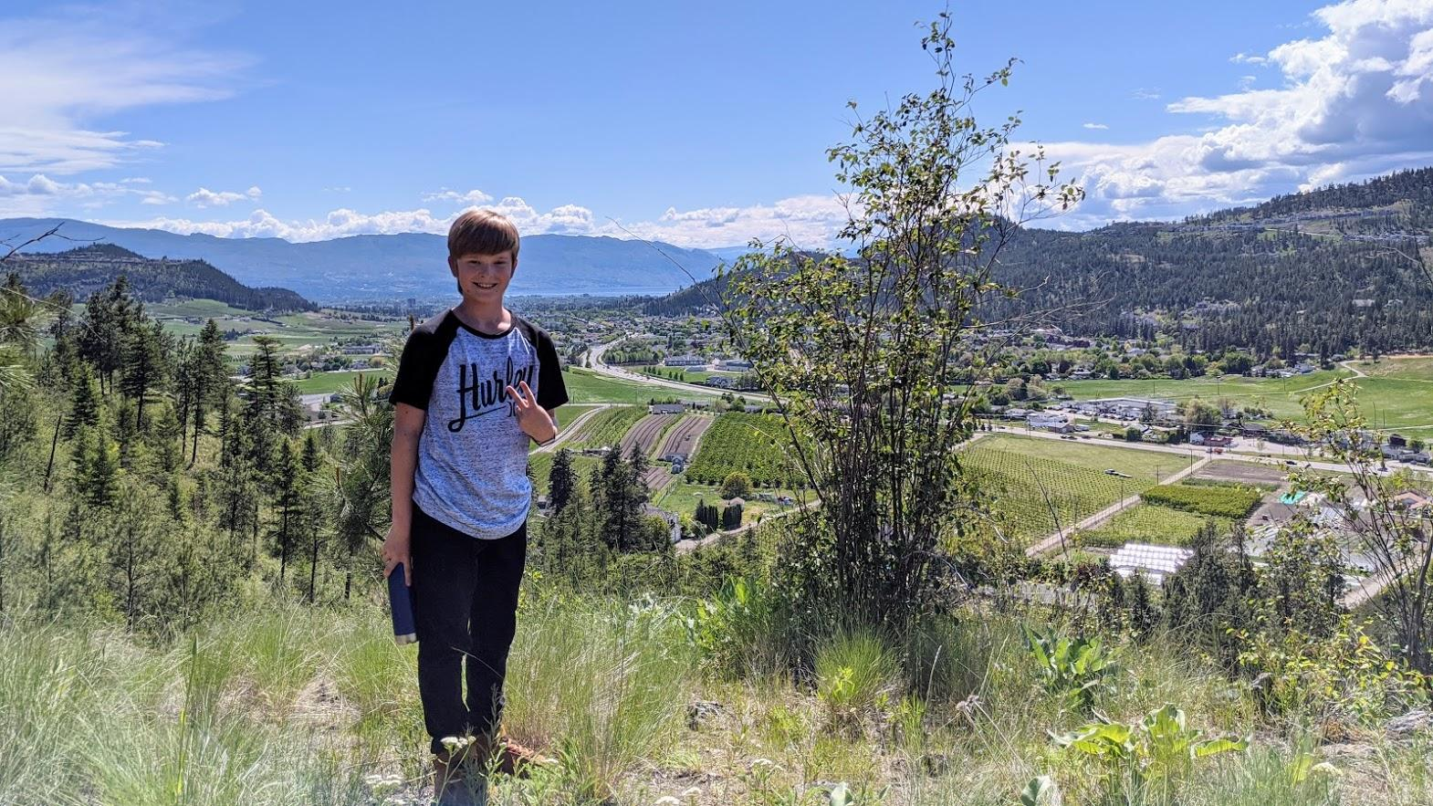
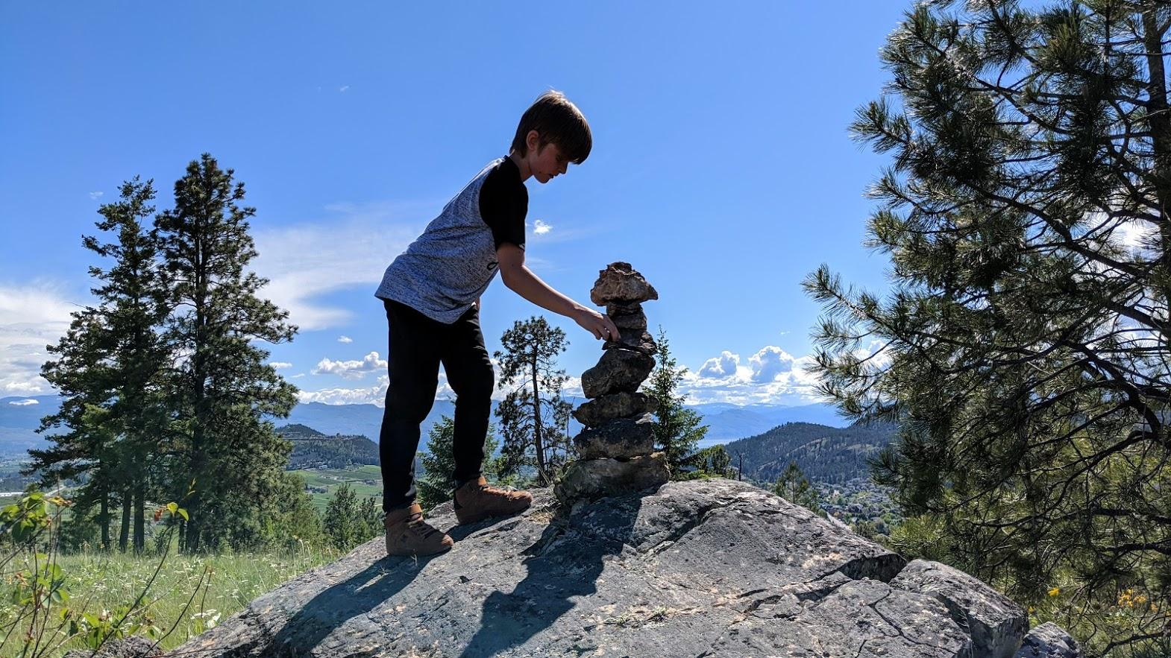
Asher Brandel
I am grateful for nature and
what it gifts us. It also gives me
feelings of peace, calm, and happiness.
This is the view when hiking to the top of the hill behind my grandparents’ house.

Slide 26
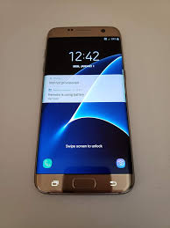
Demitri
I’m grateful for my phone because I can communicate to people through COVID-19.

Slide 27
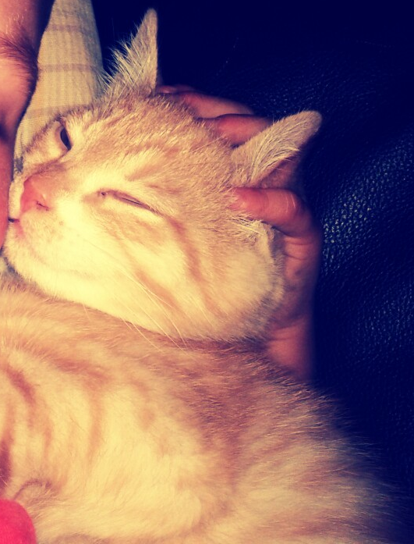
Cole Davis
I am grateful for my cat Nico because he comforts when I feel sad

Slide 28
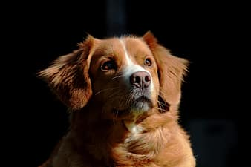
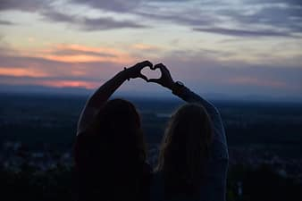
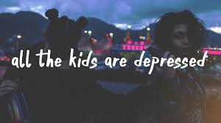
Addie
I am grateful for my sister because I like to hang out with her. Murphy, my yellow lab, is fun to cuddle and he makes me happy.i am most grateful for music.

Slide 29
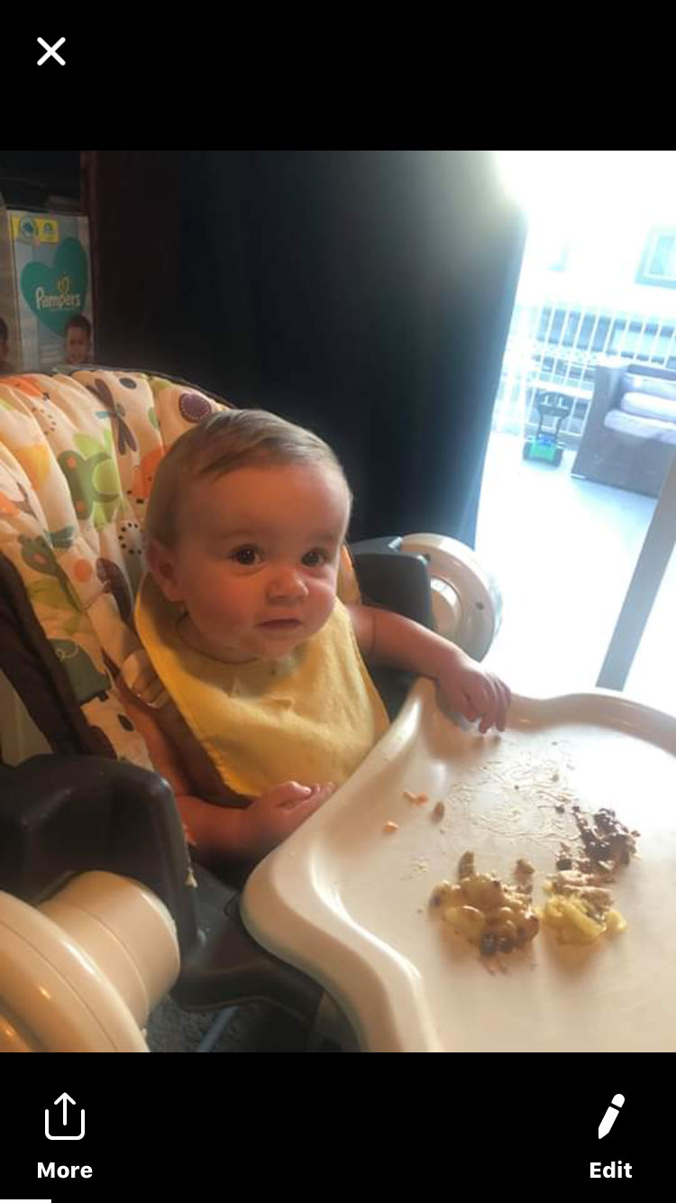
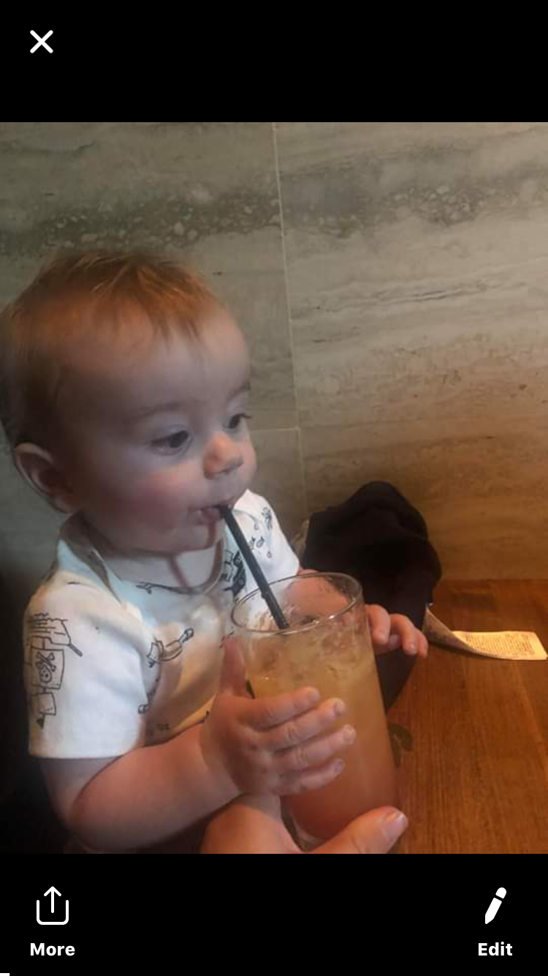
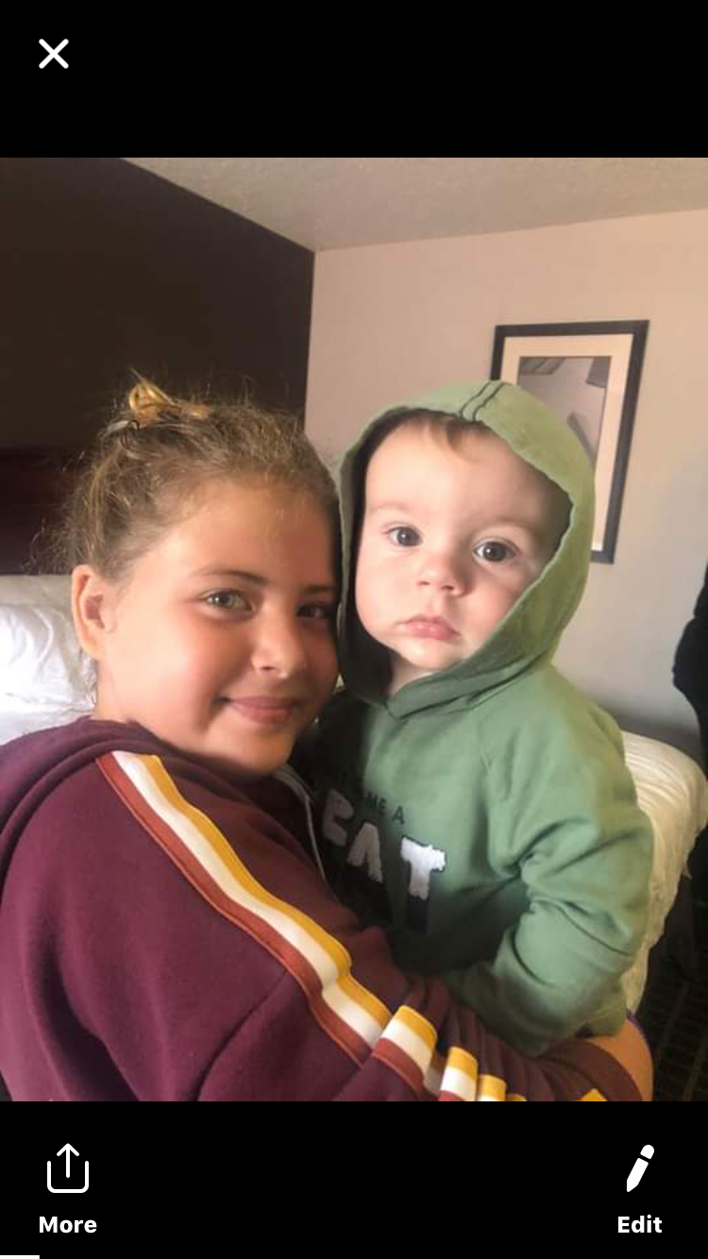
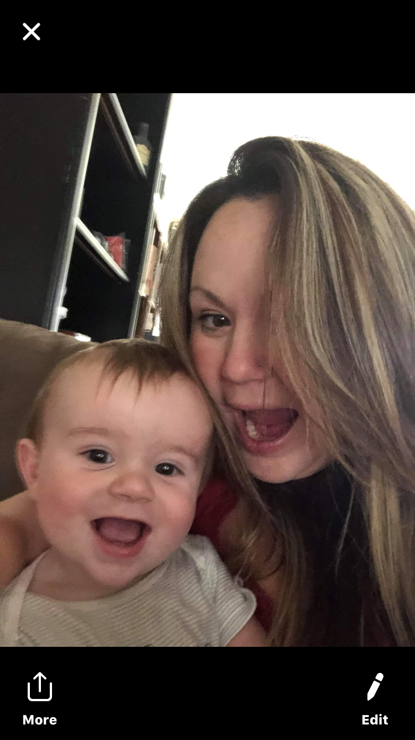
Nevaeh
I am grateful for this little guy because he is the cutest and he is so handsome!

Slide 30



Mohamed
I am grateful for my family, my love for soccer, and my teacher.

Slide 31



Sam
Spending time with my family is most important to me. Communicating with my friends is always fun. I am grateful for also getting more time to sleep.

Slide 32


Hunter
I am grateful for my family and my garden also that's my sister

Slide 33


Andres
I love my parakeets - Sunny & Canala.
My family is special and I like to play basketball and soccer

Slide 34

We hope you enjoyed viewing our 30 - Day Gratitude Photo Project.
Team Samaddar
June 26th, 2020

